Slide 1
D.H. Kim
Notes:
Welcome!
My name is DH Kim, and I will be the voice behind a series of videos composing Causal Beast, a primer on causal inference.

Slide 2
HELLO!
I am D.H. Kim
I love causal inference
I am a data scientist
You can find me at @dhexonian
Notes:
Just in case anyone was curious, this is what I currently look like.
And if you have any questions along the way about the course, feel free to reach out!

Slide 3
Introduction
Purpose of this course
Notes:
I want to start the course with some reasons for why I think it’s useful to learn causal inference.
That way, you can quickly judge for yourself whether spending your time with me in this course would be a good use of your time.

Slide 4
Universal Dislike for Uncertainty
We’re neurologically wired to perceive anything uncertain as a potential threat
Our brains dislike uncertainty so much that they create certainty in four key ways
Notes:
My pitch for why causal inference is useful to learn, starts with the fact that we all hate uncertainty.
Scientists have shown that we’re neurologically wired to perceive anything uncertain as a potential threat.
Thankfully, all of our brains are wired to attend to some well studied cognitive methods in order to lesson some of the uncertainties in our lives.

Slide 5
(1) Attending to the Familiar
Choosing among the most popular
Doing nothing or choosing the default
Notes:
The first way we try to reduce uncertainty is by attending to the familiar
And one common way we do this is by choosing the most popular thing.
For example, when choosing between phones, we choose among the most popular smartphones like the Samsung Galaxy or the Google Pixel, effectively reducing our uncertainty to just those two phones.
Another way we attend to the familiar is by choosing the default. To continue the phone analogy, many of us keep our default phone settings because we’re uncertain about what changing them might do to our phones.

Slide 6
(2) Making Stuff Up
Apophenia
“Unmotivated seeing of connections [accompanied by] a specific feeling of abnormal meaningfulness”
E.g. seeing intricate things in clouds like dogs
Notes:
The second way we try to reduce uncertainty is by artificially creating meaning. The scary thing is we’re not really intentional with this approach. It operates slightly under the radar of our consciousness through a psychological phenomenon called apophenia.
You have apophenia if you’ve ever said something to which the response was, “that’s a stretch”. An example of apophenia occurring in our visual system is seeing intricate things in clouds like dolphins and platypus, or finding the silhouette of Jesus Christ in toasted bread. Our auditory system also commits to false interpretations; sometimes we hear words in barks and meows. And in many other ways, without really meaning to, our minds create a lot of meaning from thin air to reduce uncertainty in our lives.

Slide 7
(3) Roll the Dice
Any decision is better than no decision at all because there is certainty in action
Relief comes even when the decision is suboptimal or chosen at random
Notes:
The third way we try to reduce uncertainty is by rolling the dice and making a decision. Sometimes, we feel compelled to make up our minds, thereby preventing us from deliberating any longer.
The reason? Relief. Immediate relief sets in when we decide on something, because we have by definition created certainty by committing to something, and we no longer have to wonder whether we made the right decision since it doesn’t really matter anymore. Everything is off the table. What’s done is done.

Slide 8
(4) Using Data
We always feel it in our hearts that we can do better than #1, #2 and #3—we prefer using data
Data = Information
But what kind of information? What is the kind of evidence called?
Notes:
The fourth and final way we reduce uncertainty is by using data, which is our most preferred way to deal with uncertainty, because we’ve always felt it in our hearts as rationalists that we can do better than just attending to the familiar, making stuff up, and rolling the dice.
We prefer using data because data is information, particulars, which by definition are informative. And by informative, we mean they are able to reduce the uncertainties around our decisions.

Slide 9
Causal Information
The most preferred type of information to reduce uncertainties
Notes:
To be even more specific than acquiring information, I’d like you to consider acquiring causal information as the most preferred type of information to reduce uncertainties around our decisions.
Why is that? Because causal information helps people understand why things happen, and therefore, make decisions which actually cause the effects that are desirable.

Slide 10
Rules of Thumb to Guide Desirable Effects
Health
More healthy is better than less healthy
Productivity
More productive is better than less productive
Income
Higher income is better than less income
Employment
More employment is better than less employment
Notes:
It's intuitive that we want to make decisions which lead to desirable effects, but what do we actually mean by desirable effects?
Here, we’re not going to get into any deep philosophical discussion on what is desirable, or undesirable, to live a good life.
Instead, we’re going to rely on what society possesses for us, good rules of thumb, to gauge which effects are desirable and which are not.
For example, an effect characterized by more health is better than less health. And there are countless more examples like more wealth is better than less wealth, more education is better than less education.
And of course there are no divine statements regarding the desirability of these effects. But the societal rules of thumb are pretty practical and work well, and we’re OK with that, which means that most of our efforts should be focused on what the causes of these well-established and desirable effects are.

Slide 11
Essence of Social Science Research
Answering causal questions
Does public healthcare improve health outcomes?
Does a sugary drink tax reduce obesity?
Are addiction clinics effective in accelerating recovery?
Notes:
You might be wondering, who is actually uncovering the causes of these desirable effects? Simply put: social science researchers.
It’s always been the mission of social scientists to uncover causal knowledge that tackles societal uncertainties of this world like:
Does public healthcare improve health outcomes?
Does a sugary drink tax reduce obesity?
Are addiction clinics effective in accelerating recovery?
Now admittedly, these are pretty broad-based questions whose answers have far-reaching effects, but might not be the type of evidence we’re looking for to help reduce the uncertainty around our more immediate dilemmas, like whether our children should attend the private school or the public school.
But you’d be surprised to know that there’s actually a fair amount of research that comes incredibly timely to our everyday questions, including whether children gain much by wages from attending private school vs. public school.

Slide 12
Causal Knowledge in Our Personal Lives
Personal uncertainties are also centered around issues of causality
Should I attend college?
Does college make people more financially well off?
Should my partner move in with me?
Does cohabitation decrease chances of divorce?
Notes:
All we have to do really is to make the diligent effort to search for our problems. I’ll give you a personal example of this. About a year ago, my partner and I were wondering if one of us should move in with the other. What we both did was spend an entire month gathering causal knowledge from social science literature, to understand whether cohabitation before marriage decreased chances of separation. And this was important to us at the time because separation was an undesirable effect for the both of us, and we needed every bit of causal evidence to assure ourselves that we were making a well-reasoned decision.
What I’m trying to explain with this example is that a lot of social science, of course, uncovers causal knowledge that is hugely impactful for its application to important policy issues like health care, foreign relations, and economic growth, but there’s also a large part of social science that can be directly and immediately applicable to familiar problems we face at home.

Slide 13
Causality in Everyday Language
Why?
Cause
Make
Create
Effect
Force
Lead to
Notes:
Causality is not something that should come to us as completely foreign. In our everyday language, there are phrases which denote causation like, “Why did this happen?”, “What caused this to happen?”. And there’s plenty of verbs to supplement our causal vocabulary. Make, create, effect, force, lead.

Slide 14
Potentially Misinforming News Sources
Notes:
And that’s actually precisely the problem, because causal phrases are used so ubiquitously without caution in their usage.
It’s common practice for papers to say, "X predicts Y", when they mean "X correlates with Y", but it misleads the majority of readers to read it as, "X causes Y".
And in hunger for information to reduce the uncertainty around our decisions, we may in haste, consume information without consideration of whether the information denotes anything about causality.
And that’s the primary utility and goal of this class. To help you carefully read and digest information, and determine if the information has anything to say about causality, so that you may correctly use information as causal evidence with which to make decisions that lead to desirable effects.

Slide 15
What is Correlation?
Correlation vs. Causation
Notes:
A discussion on causation invariably requires a discussion on correlation to differentiate the two.

Slide 16
Defining Correlation
Degree of Correlation
Measure of linear association between two variables
The value of correlation coefficient, r denotes both direction and association of the association
0 for no relationship
+1 for strong positive relationship
-1 for strong negative relationship
Strong Positive
Strong Negative
Weak Positive
Weak Negative
None
None
Notes:
Correlation is a measure of linear association between two variables. One way to see if there is a linear association between two variables is by visualizing the data through a scatter plot.
Does Y tend to increase when X increases, or does Y tend to decrease when X increases? We want to be able to answer such a question if we want to know if two variables have correlation.
The correlation coefficient, sometimes abbreviated as the lowercase r, indicates both the strength of the linear association, as well as its direction.
Let’s talk about the direction first. If the trend is sloping up, then there is a positive correlation, and therefore a positive correlation coefficient. This means that an increase in the value of one variable is associated with an increase in the value of the other variable.
If the trend is sloping down, then there is a negative correlation, and therefore a negative correlation coefficient. This means that an increase in the value of one variable is associated with a decrease in the value of another variable.
Now let’s talk about the strength of the linear association. If a straight line can be drawn perfectly through all of the data, the linear association is perfect ,meaning we either have a negative one or a positive one correlation coefficient depending on the direction of the line. The correlation coefficient in the other extreme can be 0 if we are unable to discern a linear association between two variables.

Slide 17
Correlation ≠ Causation
Sunglass vs. Ice Cream Sales
Correlation simply denotes an association, does not denote a causal relationship
Correlation between ice cream sales and sunglasses sold
What is the confounder?
Ice Cream Sales
Sunglass Sales
Notes:
We saw that the correlation coefficient is the single number that encapsulates the direction and the strength of the association between two variables.
However, we should note that correlation means just that, an association. It does not mean that a change in one variable causes a change in the other variable. In other words, correlation is not equal to causation.
To convince yourself of this, take a look at the chart which shows the positive correlation between sunglass sales and ice cream sales. Let’s think about this for a moment. Do we really believe that increase in sunglass sales causes increase in ice cream sales?
Well, not really. It’s not like people become compelled to buy ice cream when they purchase a pair of sunglasses. The more reasoned thought here is to suspect that the confounding variable is the summer heat, that’s causing both ice cream and sunglass sales to go up, and creating this spurious relationship between ice cream sales and sunglass sales.

Slide 18
Chocolate Consumption Produces Nobel Laureates?
Chocolate Consumption and Nobel Laureates
35
Sweden
Switzerland
30
Nobel Laureate production correlated with chocolate consumption
Is this causal?
What is the confounder?
25
Denmark
Austria
Norway
20
Nobel Laureate per 10 Million people
United Kingdom
15
Netherlands
Ireland
Germany
10
United States
Canada
France
Belgium
Finland
5
Portugal
Australia
Japan
Italy
0
Spain
China
Brazil
0
2
4
6
8
10
12
14
Chocolate Consumed (kg/yr/capita)
Notes:
Let’s cover one more example to imprint the message that correlation is not causation.
So the causal question is: does eating more chocolate increase a nation’s chances of winning the noble prize? Is the graphic good evidence?
Well, no. Wealthy nations probably consume more chocolate and have top academic institutions that house top notch scholars
who then win the Nobel Prize for their respective fields.
The confounding variable is probably wealth, education level, or some derivative of privilege.

Slide 19
Some Correlations are Causal...
All causal relationships have correlation
Not all correlations are causal
Burning of fossil fuel causes emission of carbon dioxide
Combustion Reaction
Notes:
We’ve established that correlation is not causation. But we should note that out of all the correlations between two variables, there are invariably going to be some correlations which are actually causal.
For example, burning fossil fuel like natural gas and oil causes emission of global warming inducing gases like carbon dioxide. For every one molecule of methane that’s burned, one molecule of carbon dioxide is produced. So burning of methane causes more carbon dioxide to be released into the atmosphere.
Hopefully this example is able to convince you that all causal relationships by definition exhibit correlation. If something causes another thing to happen, then it’s necessarily the case that there is going to be association between the two.
But as we established before, not all correlations are causal. This is kind of like the square and rectangle principle in geometry. Recall that all squares are rectangles, but not all rectangles are squares. Similarly, all causal relationships exhibit correlation, but not all correlations are causal.
In the upcoming lessons, we’ll discover various categories of correlational relationships that exist in the world, and try to think about which types are causal, and which are not.

Slide 20
Types of Correlation
Correlation comes in all shapes and sizes
Notes:
Broadly speaking, there's eight types of correlations, only 4 of which are actually causal. And we’ll cover them one by one.

Slide 21
(1) X ⇒ Y
(Direct Causation)
Education (X)
Wages (Y)
X
Y
Notes:
The first type of correlation is causal. Where variation in variable “X”, is causing variation in variable “Y”.
What do I mean by variation? Let’s suppose that the variable “X”, represents the variable, years of education, and the variable “Y”, represents the variable wages. What this graph is saying is that some variation, or change in years of education, causes some corresponding variation in wages.
If the correlation is positive, then that means a positive change in years of education causes a positive change in wages. In other words, more education causes greater wages. And equivalently, less education causes less wages.
The arrow is what’s going to denote the cause and the effect in the relationship between two variables. So here, the arrow is pointing from X to Y, which means that some variation in X causes some variation in Y.
If there is no arrow, we should note that there is no causal relationship, perhaps just correlation if there is any.

Slide 22
(2) X ⇐ Y
(Reverse Causation)
Debt (X)
Economic Growth (Y)
X
Y
Notes:
The second type of correlation is also causal. Where variation in variable “Y” is causing variation in variable “X”. Note that this is just the opposite case of direct causation. Let’s call this reverse causation, since now it’s variation in Y that is causing variation in X.
This is denoted by the arrow which points from Y to X.
An example of this type of correlation is the relationship between debt levels and economic growth, which has been a highly debated topic for some time now, in regards to the direction of the causal relationship.
On one side of the debate, we have an economist like Carmen Reinhart, who believes that high debt levels cause slow economic growth, and on the other side we have an economist like Paul Krugman, who believes that it’s slow growth which causes debt levels to rise.

Slide 23
(3) X ⇔ Y
(Cyclic Causation)
Motivation (X)
Learning (Y)
X
Y
Notes:
The third type of correlation is also causal. Let’s call it simultaneous causation, where variation in “X” and variation in “Y”, cause each other in a continuous feedback loop.
For instance, if a student's motivation is high. they are more likely to learn, but if they succeed at learning, their motivation will rise. And the cycle continues.

Slide 24
(4) X ⇒ Y ⇒ Z
(Chain)
Burglar (X)
Alarm (Y)
Sally (Z)
X ⊥ Z | Y
X
Y
Z
Notes:
The fourth type of correlation is not fully causal, but still causal in the traditional sense of the word causal.
In everyday life, causation is transitive: that is, if X causes Y, and Y causes Z, we are usually prepared to say that X causes Z, BUT only through the channel Y.
This is also called indirect or chain causation.
As an example, a burglar intrudes into the home of Sally, setting the alarm on. The alarm causes Sally to wake up.
The burglar causes Sally to wake up, but only through the alarm, for it’s the alarm that actually wakes up Sally, not the burglar.
What’s interesting with indirect causation is that any information about the burglar becomes unnecessary to say what happens to Sally if the status of the alarm is known. In other words, Z is independent of X, given Y, or put it a more familiar way, whether the burglar intrudes into Sally’s home is irrelevant to the status of Sally once we know whether the alarm rang. If we know the alarm rang, we know Sally wakes up. If the alarm didn’t ring, we know Sally is sound asleep. What the burglar does, doesn’t matter once we know the status of the alarm.

Slide 25
(5) X ⇐ Z ⇒ Y
(Fork/Confounding)
Z
Aircraft tire sales (X)
Rail part sales (Y)
Tariffs (Z)
X ⊥ Y | Z
X
Y
Notes:
Let's now talk about the types of correlations that are not causal. And we can visualize this by there not being an arrow between variables “X” and “Y”. The variations in X and Y are caused by something else, namely the variation in variable Z.
And we know this because there are two arrows pointing out from Z to variables X and Y. So the representation tells us that there is a causal relationship between Z and X, and Z and Y.
But our focus will be on the association between variables X and Y, which is not causal.
An example of this type of correlation between “X” and “Y” is the recent U.S. tariffs against Chinese aircraft tires and rail parts. Whether there is a tariff imposed by the U.S. on China is represented by variable “Z”, and the sales of those two products, aircraft tires, and rail parts, which are both affected by the tariffs, are variables “X” and “Y”.
So what the graph tells us is that the changing status of the tariffs causes variation in sales of Chinese aircraft tires and rail parts.
More concretely, tariffs imposed on China causes both Chinese aircraft tires and rail parts sales to go down.
And the absence of a tariff conversely causes both Chinese aircraft tires and rail parts sales to go up.
This means that there is a positive correlation between Chinese aircraft tires and rail parts sales. They move together in the same direction.
But note that this spurious relationship between Chinese aircraft tires and rail parts exists solely because of the common variable tariffs, which actually has a causal relationship with both aircraft tires and rail parts sales.
It’s not that Chinese aircraft tires have any causal effect on Chinese rail parts. In other words, decreasing Chinese aircraft sales do not cause Chinese rail parts sales to go down. Tariffs do that. And conversely, increasing Chinese aircraft sales do not cause increasing Chinese rail parts sales. The elimination of tariffs do that.
And we know this fact because we observe the value of variable “Z”, whether there is a tariff in place. But when we do not observe “Z”, we become blind to the true cause of the variations in X and Y, the sales of Chinese aircraft tires and rail parts in this case, and find ourselves believing “X” and “Y” to have a causal relationship.
We’ll discuss this Z variable more later in other modules, but for now, just take note that “Z” is called a confounding variable because it confounds or obscures the true relationship between X and Y, which we mistake for a causal one when “Z” is not observed.

Slide 26
(6) X ≡ Y
(Tautology)
Fahrenheit (X)
Celsius (Y)
X ≡ Y
X
Y
≡
Notes:
The sixth type of correlation is also not causal, and this is due to equivalence. X and Y are equivalent. Therefore, they exhibit perfect correlation.
If the temperature is zero degrees Celsius, then it is 32 degrees Fahrenheit. One doesn't cause the other. It is just another way of referring to or describing the same thing. They will be perfectly correlated, and certainly not because of causation.

Slide 27
(7) X ⇒ Z ⇐ Y
(Collider)
X
Y
Battery (X)
Gas tank (Y)
Car running? (Z)
X ⊥̸ Y | Z
Z
Notes:
The seventh type of correlation is also not causal, and we visualize this by there not being an arrow between variables “X” and “Y”.
But there is an arrow between variables “X” and “Z”, and variables “Y” and “Z”, which means that variations in “X” and “Y” both cause variation in “Z”. So there is a causal relationship between those two pairs. But our focus will be on the correlation between X and Y, which is not causal.
An example of this type of correlation between variables “X” and “Y”, is a car’s battery status, and tank status, which affect whether the car starts.
Let “X” be a variable that tells us whether we have a working battery, let “Y” be a variable that tells us whether there is gas in the tank, and let “Z” be a variable that tells us whether the car runs.
In this example, knowing that the battery is charged means nothing about whether there is gas, but knowing that the battery is charged, AND that the car won't start, means that the gas tank must be empty. What this example is showing us, is that while battery and gas tank status are independent variables, they are nevertheless made dependent and correlated, when the common effect, whether the car runs is known.
The variable “Z” is called a collider variable and it’s what induces a spurious association between two parent variables, X and Y, that don’t cause each other, and share no common cause, but are made dependent through the common effect they cause.

Slide 28
(8) Coincidence
Radish sales (X)
# of forest fires in California (Y)
X
Y
Notes:
The last type of correlation is also not causal. We call this a coincidence, which is best exemplified by examples from Tyler Vigen, a management consultant, who had maintained a blog about coincidental correlations.

Slide 29
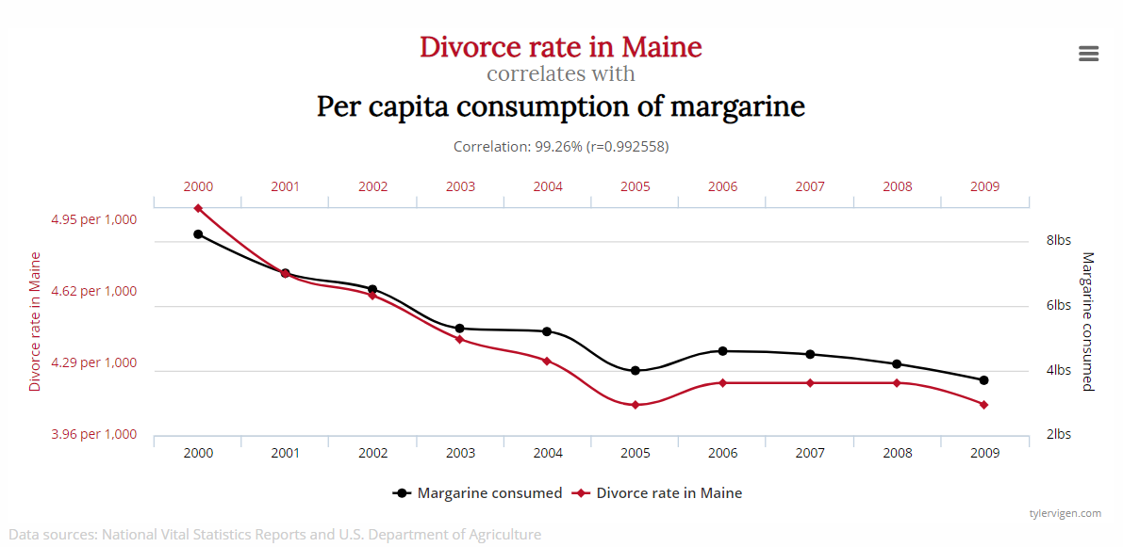
Coincidental Association Example 1
Notes:
This example: the divorce rate in Maine correlates with the per capita consumption of margarine. Hopefully, you are convinced that this is pure coincidence.

Slide 30
Coincidental Association Example 2
Notes:
Another example: number of letters in winning word of scripps national spelling bee correlates with the number of people killed by venomous spiders. Again, pure coincidence.

Slide 31
Causality Checklist
Making sure all the boxes are ticked off
Notes:
Now we know all 8 types of correlational structures. However, we should really only pay attention to the causal types, since that’s what we’re after. I only wanted to show you all the scenarios to give you broader perspective, so that you can be wary of all the scenarios where the relationship is not causal.

Slide 32
Causality Checklist
Time order
Co-variation
Significance
Rationale
Non-spuriousness
Notes:
There is a checklist to figure out if there is enough evidence to say that a causal relationship exists between a set of variables.
And broadly speaking, there are five boxes that need to be checked, and they are: time order, co-variation, significance, rationale, and non-spuriousness. We’ll talk about them one by one.

Slide 33
(1) Time Order
Cause must have occurred before the effect
For X to cause Y, it must be the case that X occurs before Y
Notes:
The first thing we have to note is the time order, where the cause must have occurred before the effect.
And this makes sense because for X to cause Y, it must be the case that X occurs before Y.
As an example, if we want to study if smoking causes cancer, we are necessarily supposing that smoking precedes cancer.
Otherwise, we have to reframe our question, and say that we want to study if cancer causes smoking, which admittedly sounds silly.

Slide 34
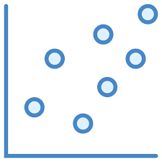
(2) Covariation
Statistical association (need to have at least some correlation)
Remember, covariation is a necessary but insufficient condition for causality
Notes:
The second requirement is co-variation, which is another way of saying that there must be correlation between two variables of interest. Otherwise, there wouldn’t be a causal relationship, for no correlation means that there is no measurable association between two variables. And for X to have caused Y, there is necessarily an association.

Slide 35
(3) Significance
Are the effects observed due to random chance?
Imprecise estimates
Notes:
The third requirement is significance.
What significance means is that in any study that involves studying a sample of a population, there is always the possibility that the sample is not representative of the population.
For example, suppose we take a random sample of the heights of people in the U.S. to get a feel for the average height of U.S. residents. But in our sample of 10 people, we get really unlucky, and get three basketball players, greatly skewing the average height upwards.
Similarly in our study, we may collect data from a sample of the population, and observe a causal relationship between two variables that could have just occurred by chance.
We can cover the statistics later when we get to it, but for now, just know that we are going to check for the statistical significance of the causal effect that we observe in our sample, so that we can confidently say that the causal effect is real, and not due to chance.

Slide 36
(4) Rationale
Logical, compelling explanation for causal relationship
“Just because” does not suffice
Notes:
The fourth requirement is that there is rationale, meaning a logical compelling explanation for a causal relationship. “Just because”, is not a good rationale for explaining why there is a causal relationship.
This is a pretty underrated requirement to establish causality, and maybe so, because it comes as obvious to most of us that there must be an understandable rationale behind a causal relationship.

Slide 37
(5) Non-spuriousness
Must be established that X, and only X, was the cause of changes in Y
Rival explanations must be ruled out
Notes:
The last thing on the checklist, is to check for spuriousness, which means that we have to be sure that it’s the variation in “X” that causes the variation in “Y”, and nothing else. There can’t be a variation in “W”, or some other variable that is actually causing the variation in “Y”.
Simply put, rival explanations must be ruled out.

Slide 38
Ceteris Paribus
The foundation of causal inference
Notes:
Eliminating rival explanations, as it turns out, is one of the hardest checks we have to accomplish in our causal inference checklist.
We’re going to dedicate this whole module to introduce the basic theory of how to eliminate rival explanations and infer causality.

Slide 39
Bivariate Case
X
Most causal theories are bivariate; they ask whether X causes Y
But crucially, even though our theory might be bivariate, the real world is is multivariate—every interesting phenomenon has several causes
Y
Notes:
So far, we have only been talking about the bivariate case of causal inference, where there are two variables of causal interest: where variation in “X” causes variation in “Y”.
But crucially, even though we have discussed the bivariate cases, the real world is multivariate. That is, for every interesting phenomenon, there are several causes, like probably in the hundreds or thousands. So it can’t be just variation in X that causes variation in Y.
If this is hard to believe, just think about how many things cause you to become happy. For me personally, off the top of my head, hanging out with family and friends, exercising, eating good food, playing video games. There’s definitely more than one.
So if we live in a multivariate world, where there are many causes for a single effect, and our discussions on causal inference have been bivariate, where there is one cause to one effect, i.e., variation in X causes variation in Y, you may be wondering why we even bothered discussing the bivariate case when the world is clearly not bivariate.
And the answer is pretty simple. We are unable to figure out multiple causes of a single effect all at once. To convince yourself of this, imagine hundreds of variables which are varying all at once, and your goal is to answer which variations in the variables caused a specific effect. Pretty impossible to do unless you start making grand assumptions.
This is precisely why we restrict our attention to the bivariate case, and focus on one variable of interest, X, and its causal effect on another variable Y.

Slide 40
Multivariate World
X
W
Theories are bivariate but the world is multivariate
Need to control for all other factors W
We call controlling for all other factors ceteris paribus
Y
Notes:
To show that X and Y have a causal relationship, we need to think about how we can control for all other possible sources of variation.
What do we mean by controlling for other possible sources of variation? Well, note that when we’re trying to figure out whether variation in X causes variation in Y, we have to make sure that rival explanations have to be ruled out. This was the non-spuriousness check we had to make to infer a causal relationship between X and Y.
And those rival explanations are variations in other variables that could have a causal effect on the variation in Y.
Let’s group such rival explanations into a variable, W.
So how can we rule out "W" in our analysis of the causal relationship between X and Y? We restrict their variation, meaning we hold them constant. And this is important because if you can recall from an earlier discussion, we said that a causal relationship necessarily exhibits correlation, meaning that variation in one variable causes variation in another variable. If we don’t allow W to vary, and we only allow X to vary, W cannot have a causal relationship with Y, and any variation in Y becomes solely attributed to the variation in X. In this way, we can show that X and Y have a causal relationship, by holding all other factors constant.
We call this concept of holding all else constant, or controlling for all other variables, except the causal variable of interest, X, and the effect variable of interest, Y, the ceteris paribus condition, which directly translated from Latin means, all other things being equal.
When thinking about causal inference, we should be very careful to note whether the conditions of our analysis are ceteris paribus, where everything but the X variable is held constant, such that variation in X, becomes the exclusive cause of variation in Y.

Slide 41
Controlled (Scientific) Experiment
Treatment Group
Control Group
Establish ceteris paribus with tight control of all relevant variables — means that treatment and control group are near replicas
Because they are otherwise equal in every way, difference in outcomes will be attributed to the fact that only one group has received the treatment
X
treatment
control
Y
Treatment Outcome
Control Outcome
Notes:
The most direct and intuitive way to create a ceteris paribus environment is to conduct what is called a controlled experiment, also known as the scientific experiment.
The controlled experiment establishes ceteris paribus by creating two identical groups of subjects. Those two groups we call the control group and the treatment group.
What distinguishes the treatment group from the control group is that the treatment group receives a treatment, and the control group receives no such treatment.
A treatment is any measurable change that we are going to induce in the treatment variable for the treatment group to affect the outcome variable.
The outcome of the treatment group is the treatment outcome, and the outcome of the control group is the control outcome.
How does this setup comply with our earlier discussion of causal inference. Of showing that variation in “X” causes variation in “Y”.
Well, the variation in treatment variable is the cause. Remember, one group receives treatment and the other group receives no such treatment. This is the source of variation in the treatment variable X.
And the variation or difference between the treatment outcome and the control outcome is the variation in Y.
In summary, we have variation in the treatment variable and variation in the outcome variable, which enables us to discern a causal relationship between the two.
This will become more clear with the upcoming examples.

Slide 42
The 8th Grade Science Fair
Does sunlight make plants grow plants?
Clone “new” plants by clipping the plant and taking the cuttings to grow it elsewhere
Then put one clone under darkness and another under artificial light
Notes:
We’re actually quite familiar with the controlled experiment, because we most likely tried one as part of a middle school science project. I think everyone at one point has tried the science project, where you’re testing the causal effect of light on plant growth.
If you’re not familiar with it, it’s quite simple. You create genetically identical plants by clipping one plant and taking the cuttings to grow them elsewhere. That way ,we have plants that are all identical.
Then you take some plants into a dark environment, and the other plants into an environment with artificial light. After some period of time, you measure the plant growth.
If there are differences between the plants in the dark environment and the plants in a lighted environment, you conclude that the differences are due to sunlight. Why? Because these are two groups of plants which are identical except for their exposure to light.
The plants treated with light make up the treatment group and the plants that are not treated with light make up the control group. The treatment variable is the exposure to light, and it can only take on two values: one where the plant is exposed to light, and the other where the plant is not exposed to light. And that’s the source of variation in the causal variable, which we made the habit of labeling as the “X” variable.
The outcome variable is the growth of the plant. We have two outcomes because there are two groups. The treatment outcome is the average growth of the plants in the treatment group, and the control outcome is the average growth of the plants in the control group. And that’s the source of variation in the outcome variables, which we made the habit of labeling as the “Y” variable.
Now we have variation in “X” and variation in “Y”. It seems like we are now ready to say that variation in “X” causes variation in “Y”.
Are we all set to go? Well not quite. We have to go through our causal inference checklist to be sure.

Slide 43
Does it Check the Boxes?
Time order
Co-variation
Significance
Rationale
Non-spuriousness
Notes:
Time-order
Does the cause occur before the effect? Yes, because we measured the average growth of the plants, after we had already placed the two groups of plants into their respective treatment statuses: one with light and one without the light
Co-variation
Is there correlation between the treatment variable and the outcome variable? Yes, because the plants treated with light grew more than the plants that were not treated with light.
Significance
Is there statistical significance? Since we don’t actually have any numbers to calculate significance, let’s skip this one for now and assume that indeed the causal effect of light treatment is real and not due to chance.
Rationale
Is there a reason behind this causal relationship? Yes, light is a key ingredient in the photosynthesis process which helps plants grow.
Non-spuriousness
Is there non-spuriousness? The plants are all identical because they are genetic clones to control for differences between subjects of the study. However, there are still some possible confounders, if the lit environment and the dark environment are different in other ways besides the fact that one environment is lit and the other environment is dark. We would have to make sure that the temperature levels, humidity levels, soil quality, the pH of the water and other possible confounders are held constant or equal in both groups.

Slide 44
Impracticability of Controlled Experiments in Social Science
Controlled experiments require sameness of subjects (e.g. identical plants, compounds, climates, etc.)
Even if possible, experimentation on people is morally questionable
Notes:
Controlled experiments such as the one we covered earlier fundamentally require sameness of subjects like identical plants, identical compounds and identical climates. However, this is impracticable in the setting of social science research.
And one big reason is because the subjects in social science are people, and we cannot replicate people like we can with plants, animals, molecules and chemical compounds.
Furthermore, even if cloning people was not a morally reprehensible thing, experimentation on people is morally questionable.
And as we will find out in a causal inference technique called randomized experiments, social scientists do actually experiment on people, but they do so after going through extensive checks to ensure that their experiments won’t hurt people’s lives.

Slide 45
Measurement
What are we trying to measure?
Notes:
In this section, we’re going to set the proper foundation for the first causal inference technique, randomized experiments.

Slide 46
Two roads diverged in a yellow wood, and sorry I could not travel both and be one traveler, long I stood and looked down one as far as I could to where it bent in the undergrowth;
…
Two roads diverged in a wood, and I— I took the one less traveled by, and that has made all the difference.
Road Not Taken (Robert Frost)
Notes:
But first, I want to discuss a poem called Road Not Taken by the American poet Robert Frost that is actually pretty relevant to our discussion of ceteris paribus as a requirement for doing causal inference
In “The Road Not Taken”, Robert Frost uses the metaphor of crossroads to describe the causal effect of personal choice and fulfillment. The narrator says that his choice in taking the road less traveled has made all the difference, but in reality we know this to be unprovable. Being only one person, he couldn’t actually be sure. Maybe the road more traveled could have made an even bigger difference on the narrator’s life.
Feeling curious, the narrator may want to revisit the road more traveled at a later date, and compare it to the road less traveled. But this won’t work either. The narrator would be older, much wiser, and different in other ways than his old self who had taken the road less traveled by.
Then how can we preserve ceteris paribus here. The answer is: by varying the treatment variable simultaneously for the same person, and observing both the control and treatment outcome. But this is impossible. Because variation in treatment status cannot be made simultaneously. A person cannot both have taken the road less traveled by, and the road more traveled by.
You may be wondering how this situation differs from the plant example, when we talked about controlled experiments.
For one, a plant cannot simultaneously be treated with light, and not treated with light. After all, it’s not like there is a parallel universe that allows for simultaneity.
But we were still able to uphold ceteris paribus, because simultaneity is exactly what the controlled experiment emulates. Because we have two groups of plants which are genetically identical, grown under the exact same environments except the treatment status, we are able to observe very accurately what would have happened to the group of plants that had received the light treatment had they not received the light treatment.
And how do we observe this exactly? We take a look at the control outcome, the outcome of the plants which had not received the light treatment. The control outcome mimics the counterfactual: what would have happened in the absence of the treatment.
In summary, because the two plants that went on their separate roads were identical, comparison of the treatment outcome and control outcome is done ceteris paribus, and we are able to confidently say whether the treatment has made all the difference. Mr. Frost, not so much...

Slide 47
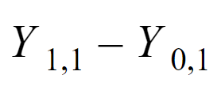
Unit Level Effect of Treatment
is the outcome of the jth subject given treatment i where if i=0 the subject is not treated and if i=1 the subject is treated.
Then the unit level effects for the first subject:
Notes:
The United States is one of few wealthy countries that does not provide universal healthcare to all of its residents. But healthcare is expensive, so politicians need a compelling reason to fund it. And one really compelling reason would be a statistically and practically significant causal relationship between health insurance and health outcomes.
Our effort to understand the causal connection between health insurance and health outcomes is aided by fleshing out Robert Frost’s two-roads metaphor.
We use the letter Y as shorthand for the outcome variable of interest, health level in this case.
To make it clear that we’re talking about specific people, we’re going to use subscripts as a stand-in for people’s unique identifiers like social security number:
To make it clear that we’re talking about specific people, we use subscripts as a stand-in for people’s unique identifiers like social security number: Yi is the health level of individual i.
Facing the choice of whether or not a person gets health insurance, person i’s health has two outcomes, only one of which is observed and the other is potential. He or she may either get health insurance or not. Remember, a person cannot simultaneously live two lives or travel on two roads, one with health insurance and the other without. But we’ll write both outcomes anyways using notation.
To distinguish one outcome from the other, we add a second subscript: The treatment outcome, which is the health level with health insurance, is Y1i for person i, while the control outcome, the health level without health insurance is Y0i for person i.
The unit level causal effect of insurance on health for each person is the difference between Y1i and Y0i. This is interpreted as the causal effect of health level for just the single individual directly attributable to the variation in health insurance status.

Slide 48
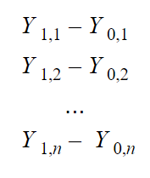
Observing all the Unit Level Treatment Effects
is the outcome of the jth subject given treatment i where if i=0 the subject is not treated and if i=1 the subject is treated.
Then the unit level effects are as follows for each subject:
Notes:
Now suppose we have a whole bunch of people, n, in total. There are a total of n people or subjects that we are studying in our sample. For each person in our n sized sample, we have two outcomes, one of which is observed and the other is potential.
This is detailed like this.
Y11 is the health level of the person 1 who is treated with health insurance. Y01 is the health level of person 1 who is not treated and does not have health insurance. Their difference is the unit level causal effect of having health insurance for person 1.
And similarly:
Y12 is the health level of the person 2 who is treated with health insurance. And Y02 is the health level of person 2 who is not treated and does not have health insurance. Their difference is the unit level causal effect of having health insurance for person 2.
And we continue the notation this way until we have the unit level causal effect for all n people in our study.

Slide 49
Average Treatment Effect
is the outcome of the jth subject given treatment i where if i=0 the subject is not treated and if i=1 the subject is treated.
Then the unit level effects are as follows for each subject:
Notes:
Using all of these unit level causal effects, we are going to calculate the average treatment effect of having health insurance.
We do this by summing all of the unit level causal effects and dividing the sum by the number of subjects, which is n.
Why do we do this? We do this because we’re not very interested in the unit level causal effect because it’s specific to each person. We don’t really care if health insurance improves the health of Jane, Bob, or anyone in particular. We really care about the average trend, whether health insurance improves the health outcomes of the general population.
The average treatment effect, we denote as lowercase k.

Slide 50
Example of Calculating Average Treatment Effect
Subject | w/ Treatment | w/o Treatment | Unit Level Treatment Effect
1 | 5 | 4 | 1
2 | 4 | 2 | 2
3 | 3 | 4 | -1
4 | 5 | 3 | 2
Total Treatment Effect = 1+2-1+2 = 4
Average Treatment Effect = 4/4 = 1
Notes:
Let's visualize what we have been discussing in a table.
In this table, there are just 4 units or individuals. We have their Y0 and Y1, the health outcome with health insurance and the health outcome without health insurance. We take their differences and come up with the unit level causal effect for each subject.
Then we take the sum of the unit level causal effects, which comes out to be 4. And we divide this number by 4, the number of people in our sample to get the average treatment effect of 1.
This positive number is evidence of a causal relationship between health insurance and health levels. More concretely, there is a positive relationship, meaning getting health insurance improves a person’s health by 1, on average, if they didn’t already have health insurance, all else equal.

Slide 51
Difference Between Treatment and Control Group Means
Subject | w/ Treatment | w/o Treatment | Unit Level Treatment Effect
1 | 5 | ? | ?
2 | ? | 2 | ?
3 | 3 | ? | ?
4 | ? | 3 | ?
Average of w/treatment = 4
Average of w/o treatment = 2.5
Diff = 1.5
Notes:
But if you can remember our discussion on the impossibility of Robert Frost’s metaphor of observing two states, treatment outcome and control outcome, we will begin to realize that our data will inevitably look like this. Where there is missing data for each subject.
Because a person will either be treated or not be treated with health insurance, either Y1 ,or Y0 will be missing for each subject.
This means that the unit level causal effect is unsolvable now. And we knew this all along.
So what can we do? Well one way is to estimate the treatment effect by taking the difference of group means, that is, we take the average of the Y1 of all those that have insurance, and subtract it by the average of the Y0 of all those that don’t have insurance.
The end result is that we have 1.5 as an estimated average treatment effect. This is clearly not equal to the actual average treatment effect of 1 that we calculated earlier.

Slide 52
Difference Between Group Means is Biased
Assume constant level treatment effect
Treatment Outcome
Control Outcome
Average Y0 of insured group (unobservable)
Average Y0 of uninsured group (observable)
Notes:
Let’s talk about what happens mathematically when we take the simple difference of each group’s outcome means, to see why our estimated average treatment effect of 1.5, deviates from the actual average treatment effect of 1.
If you’re not familiar with the mathematical notation, that’s totally fine. I’ll translate the notation into words.
So basically, the math is saying that although we’re after the average treatment effect involving everyone’s Y0, and Y1, the data we have, only contains the Y1 for the treated, and the Y0 for the untreated, which is exactly what we saw with the holes in our data.
This is why we estimated the average treatment effect by taking the average of the Y1 of all those that are treated, and subtract it by the average of the Y0 of all those that are untreated. This is called taking the simple difference of group means.
The math shows us that such a calculation equals the average treatment effect, plus the difference in average Y0, between the treatment group and the control group.
Remember, this second term, the average Y0 for the uninsured is just the average health level of the people that are uninsured if they didn’t have insurance. This value then, is something we can actually measure.
Let’s take a look at the first term. This term the average Y0 for the insured, is the average health level of the people that have health insurance, if they didn’t have health insurance. And this is something that is unobservable, because these people already have insurance. They’ve already taken the road of “with insurance”. So this value is hypothetical in the sense that it cannot be directly measured.
So we’ve just shown mathematically that simple difference of group means is the average treatment effect, plus the difference between two terms representing the average Y0 of the treatment group and the control group.
Social science researchers call this difference selection bias, which means that the two groups of people: those with insurance and those without insurance, are not apples to apples comparisons. That is, they are not ceteris paribus. The insured and uninsured are different in other ways besides just their insurance status.

Slide 53
Insurance Example is Not Ceteris Paribus
Insured
Has insurance
Majority above poverty line
Majority White
Majority employed
Majority university educated
Uninsured
Doesn’t have insurance
Majority below poverty line
Majority Hispanic or Black
Majority unemployed
Majority high school educated or less
Notes:
How do we know that the two groups of people are different? Well, the people that have insurance are most likely wealthy, educated, employed, and already healthy.
And recall that we only want to know the causal effect of insurance on health. Not the causal effect of having insurance, being wealthy, being employed, and being educated, and this is exactly what we are deriving when we compare two groups, by taking the difference between their average outcomes.
To disentangle the pure insurance effect from the differences in wealth, employment status, and education, among other things, we have to make sure that all other factors are equal, so that the only thing that is different between the insured and the uninsured, is insurance status.
The important role that ceteris paribus plays in deriving a causal relationship should be imprinted pretty securely in our brains by now.

Slide 54
Randomized Experiment
The best way to remove selection bias
Notes:
From our earlier discussion, we learned that simple comparisons between two groups of people are not the right way to infer causal relationships.
But unfortunately, it’s common to see simple comparisons being gainfully employed in argumentation as evidence of causal effects.
The problem with this again refers back to the ceteris paribus condition, or lack thereof. Other things must be equal. Comparisons of people with treatment and without treatment have to be apples to apples, otherwise, we have a selection bias problem.
In the controlled experiment, we claimed equivalence between our control group and our treatment group, because our subjects were engineered to be identical, which meant that there was no difference in the average pre-treatment outcome, between the treatment group and the control group. And this meant no selection bias.
We want to claim something similar in our health insurance example. We want to claim that people in the control group and treatment group are near-identical.
The next causal inference technique we will learn effectively eliminates selection bias, and it’s called randomized experiments.

Slide 55
Toolbox
Randomized Experiment
Notes:
This is the graphic that’s going to delineate our progress for us. As you can see, the first causal inference technique in our toolbox is going to be randomized experiments. And there’s going to be four more techniques after that, which will complete our toolbox.

Slide 56
Review from Last Module
Treatment Outcome
Control Outcome
Notes:
Let’s do some reviewing from the earlier module.
Remember that to ensure a bivariate causal relationship between the treatment variable and the outcome variable, we want to fix everything but the treatment status as constant and equal. But we noted that the people that are already enrolled in health insurance are different than those who are not enrolled in health insurance in ways besides the fact that one group has enrolled in health insurance and the other has not.
For one, the insured are healthier for all sorts of reasons, including, perhaps, the causal effect of insurance. But the insured are also healthier because they are more educated and wealthy, among other things. These unobserved variables that are not held constant to ensure ceteris paribus are called confounders. They are what cause apples to oranges comparisons and therefore selection bias.
So how should we make apples to apples comparisons between the insured and the uninsured?
Well one way is try to make the blend of people in the treatment and control group very similar, which is exactly what a randomized experiment tries to accomplish through random assignment.

Slide 57
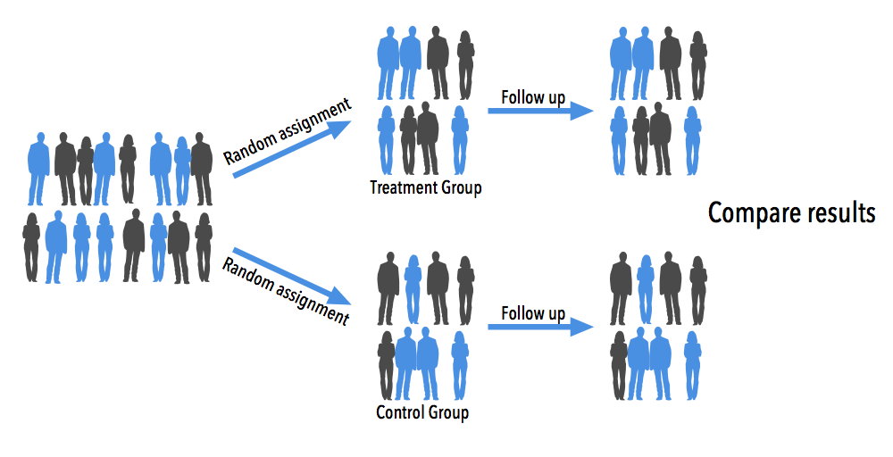
Randomized Experiment Design
Treatment group and control group created by random assignment differ only in treatment assignment and any consequences that follow
Pre-treatment outcomes are equivalent on average
Notes:
The logistics of a randomized experiment, sometimes called a randomized trial, can be complex depending on the experimental design, but the logic is simple.
To study the effects of health insurance in a randomized experiment, we first randomly sample a large number of people who are currently uninsured.
Then we randomly assign about half of the people in our sample to the treatment group, and provide health insurance to everyone in the treatment group. The other half of the people in our sample that are not assigned to the treatment group, get assigned to the control group, and continue to be without health insurance.
We wait for some period of time so that the effect of health insurance kicks in. Then, we measure the health levels of the people in the treatment group and the control group and compare the two. Any difference that is measured between control group and treatment group reflects the treatment effect or the impact of insurance on health level.
Why? Because random assignment makes the group comparison ceteris paribus: groups insured and uninsured by random assignment differ only in their insurance status and any consequences that follow from it.
Why does random assignment do this? Because random assignment is random! It’s not biased towards putting any person into treatment group over the control group. And we don’t give people a chance to self-select themselves into a particular group.
We should quickly note here that random assignment of subjects to treatment and control group may not produce two groups that are near equivalent.
And this is precisely due to chance. We might get unlucky and get two groups of people who are not alike.
The cure to mitigate the effects of chance is larger sample size. You can imagine a random assignment regime of hundreds if not thousands of people to each group, so that probabilistically the two groups will be similar.
This fact is mathematically guaranteed by a property called the law of large numbers.

Slide 58
Perry Preschool Project Experiment
123 children in Ypsilanti, Michigan
Half of them (drawn at random) entered the Perry Preschool Program at 3 or 4 years old
Education for 30 weeks by skilled professionals in nurseries and kindergarten
Notes:
The best way to learn causal inference techniques is by seeing how they are used in real life.
Let’s head right into an example of a randomized experiment with the Perry Preschool Project, which was carried out for 5 years from 1962 to 1967, which provided preschool education to at-risk African American children living in Ypsilanti, Michigan.
123 children were randomly sampled from the population and about half of that were randomly assigned to enter the Perry Preschool Program. And the other half continued to be without pre-school education. The program lasted about 30 weeks.
Researchers then contacted the same subjects in follow-up surveys when they turned ages fourteen, fifteen, nineteen, twenty-seven, and forty to measure the causal effect of preschool education on economic outcomes.

Slide 59
Nores, Milagros et al. (2005): Updating the Economic Impacts of the High/Scope Perry Preschool Program
 | Size (n=123) | Treatment Group | Control Group | p-value
Cognitive skills at 15 | 95 | 122.2 | 94.5 | < 0.001
University enrollment | 121 | 38% | 21% | 0.029
Jailed or arrested at least once | 121 | 31% | 51% | 0.022
Welfare | 120 | 18% | 32% | 0.044
Employed at 19 years old | 121 | 50% | 32% | 0.032
Notes:
This table is the main result coming from the most recent follow-up study done in 2005.
As you can see, the treatment group has measured higher in cognitive skills, university enrollment, and employment status.
Incarceration rates and the percentage of people on welfare are far much lower in the treatment group than the control group.
The column indicating p-values is going to indicate the statistical significance of these findings. A rule of thumb is that if the p-values are less than 5%, we can reasonably say that there is indeed a treatment effect of enrolling in the Perry Preschool Program, and it’s not just due to chance from sampling error.

Slide 60
Because children were randomly assigned to the program or a control group, differences in outcomes are probably attributable to program status… The data shows strong advantages for the treatment group in terms of higher lifetime earnings and lower criminal activity.
Nores et al. (2005)
Notes:
This is the conclusion from the authors of the study.
Because children were randomly assigned to the program or a control group, differences in outcomes are probably attributable to program status… The data shows strong advantages for the treatment group in terms of higher lifetime earnings and lower criminal activity.

Slide 61
Snow, John (1855): On the Mode of Communication of Cholera
Cholera outbreak in London
English physician John Snow identifies a natural experiment
Londoners are subscribed to water companies in an as-if random way
Notes:
How about another example. But this one from more than 160 years ago.
In 1854, there was a very serious Cholera epidemic in London, which prompted the English physician John Snow to investigate the cause.
He suspected that water contamination caused by the sewage release in the Thames River was the cause for the outbreak, but he needed evidence.
To prove this using a randomized experiment, he would have had to randomly assign people to separate groups, and force them to drink water from varying water suppliers, and subsequently measure the frequencies of Cholera deaths in each group
But Snow did not do this. Instead, he collected observational data on which addresses got their water from which water companies, and which addresses had cholera deaths.
For Snow, this data was super useful, because the data reflected a process which closely replicated an actual randomized experiment.
Snow noted that Londoners received water from water companies in a near random way, so it was almost as if people were randomly assigned to drink contaminated water, vs. non-contaminated water.

Slide 62
Snow’s Findings
Water Supplier | # Houses | Cholera Deaths | # Cholera Deaths / 10,000 Houses
Southwark & Vauxhall | 40,046 | 1,263 | 315
Lambeth | 26,107 | 98 | 37
Others | 256,423 | 1,422 | 59
Notes:
This was the main finding from Snow’s study which proved that water source was the cause of the Cholera epidemic in London.
There were three major water companies in London.
And Snow associated each company and its water supply with an address. Then he noted whether people had died in that address.
And it turned out that Southwark and Vauxhall supplied water that caused the most Cholera deaths, because Southwark and Vauxhall had been pumping water from the part of the Thames River that was near the main sewage discharge for London.
Contrast that to the Lambeth Company, which drew its water far north from the discharge. Hence, its water was less contaminated and caused less Cholera related deaths.

Slide 63
When a Random Experiment is Not Possible
Find situations that approximate randomized trials
Identification strategy: as if natural experiments
Notes:
The lesson from Snow’s study is that when we cannot do a randomized experiment, the next best thing is to find situations that mimic randomized experiments. We call these quasi experiments, or natural experiments, where there is a source of randomization that is as if randomly assigned, and not the result of an explicit randomized experiment.

Slide 64
Potential Pitfalls of Randomized Experiments
Hawthorne/John Henry Effect
Control or treatment react to being part of an experiment
Spillover Effect
Control group is affected by existence of a treatment group nearby
Heterogeneous and Implementer Effect
Same program may have different effects across contexts and target populations
Same program may have different effects depending on the implementer
Compliance Issue
Not all members of the treatment group end up receiving the treatment and benefiting
Ethics
The rationale for conducting a randomized experiment is based on the fact that researchers are genuinely uncertain over the benefits of the treatment
Notes:
Before we move on from the discussion of randomized experiments, we’ll note some potential downsides to randomized experiments.
First, the Hawthorne effect, where subjects in our study react to being part of an experiment. Therefore their outcomes may become biased.
Second, the spillover effect. Sometimes the control group becomes affected by the existence of a treatment group nearby, and therefore receive the treatment partially. In the Perry Preschool Project, you can imagine children assigned to the control group, interacting with their friends who are in the treatment group and therefore absorbing some of the treatment effect that only those in the treatment group should be receiving.
Third, the heterogeneous effect. Meaning that the same experiment may have different effects across contexts and target populations. The Perry Preschool Program focused on African American children of ages 3 and 4, so it’s conceivable that this program might not have the same magnitude of treatment effect on children of other countries or races.
Fourth, compliance issues. It’s usually the case that not all subjects in the treatment group end up participating in the program, and if they do participate, some subjects might drop out of the study.
And lastly, ethics, because the rationale for conducting a randomized experiment is based on the fact that researchers are genuinely uncertain over the benefits of the treatment.

Slide 65
Further Studies on Randomized Experiment
Miracle of Microfinance? Evidence from a Randomized Evaluation
Banerjee et al. (2013)
Health Insurance and the Demand for Medical Care: Evidence from a Randomized Experiment
Manning et al. (1987)
The Oregon Health Insurance Experiment: Evidence from the First Year
Finkelstein et al. (2011)
The Experimental Approach to Development Economics
Banerjee et Duflo (2008)
Notes:
What we’ve covered about randomized experiments, while brief, covers most of the core ideas.
If you want to learn more about randomized experiments, these are the resources I recommend.

Slide 66
Regression
Trying to stay in control
Notes:
Policy makers are often interested in the “returns to education.” Informally, the question they want to answer is as follows: If a person is given another year of education, by how much will his or her starting salary increase. As with previous examples, this is a ceteris paribus question. If we succeed in holding all other relevant factors fixed, and then find a link between education and wages, we can conclude that education has a causal effect on wages.
We can imagine an omnipotent social planner designing a randomized experiment to get at this issue, the planner would randomly sample a group of people from the population and randomly assign each person an amount of education; some people are given eight years of education, some are given twelve, some are given none, and so on.
Subsequently, the planner measures their wages. Such a randomized experiment is of course unfeasible because the ethical issues associated with randomly assigning and mandating education for a group of individuals are obvious.
Although such experimental data cannot be obtained for measuring the returns to education, we can certainly collect observational data on educational background and wages for a large group of people by accessing surveys. Unfortunately these data sets share a feature that makes it difficult to estimate the ceteris paribus return to education, and that is the fact that people choose how much education to attain; therefore, education is not determined independently of all other factors affecting wage.
We called this selection bias in our discussion of random experiments.
When we are unable to do randomized experiments, we look for other methods in our causal inference toolbox to simulate a ceteris paribus experiment. The first of these tools we will cover in the next module is regression.

Slide 67
Toolbox
Randomized Experiment
Regression (Controlled)
Notes:
The controlled regression is the 2nd causal inference technique in our toolbox.

Slide 68
Returns to Education
Educ
Regression starts by specifying a model
Start with base model: years of education determining wage
Wage
Notes:
We illustrate the idea of a controlled regression with a thought experiment on the economic returns to educational background. We want to be able to answer if schooling pays.
Suppose the only things that we think matter in life, at least as far as earnings go, is years of education. This is represented graphically as such.

Slide 69
Gender as Key Omitted Variable
Jeannine
8 years of schooling
$40,000 salary
Craig
12 years of schooling
$68,000 salary
Apples to apples?
Notes:
So we consider two people’s earnings, Craig’s and Jeannine’s. Craig stayed in school for 12 years, including highschool, while Jeannine stayed in school for 8 years. Because we’ve assumed that all that matters for earnings is years of education, Craig vs. Jeannine, we believe, is a ceteris paribus comparison.
In practice, of course, life is more complicated, and many things cause wages to go up or down. This simple example suggests one significant complication: Craig is a man, and Jeannine is a woman. Women, unfortunately, are egregiously underpaid compared to men.
The fact that Craig earns 70% as much as Jeannine, may be the effect of more education, but it also reflects a wage gap generated by other things like gender.
Now we’d like to control for the effects of gender on wages, so that we can solely focus on education’s effect on wages.

Slide 70
Comparing Within Same Gender
Jeannine (Female)
8 years of schooling
$40,000 salary
Hannah (Female)
12 years of schooling
$62,000 salary
Now apples to apples?
Notes:
To disentangle the pure education effect from the differences in gender, we’ll replace Craig with Hannah, who is also a woman, but has 12 years of schooling. Hannah and Jeannine become a ceteris paribus comparison, where the only variation is in the years of education and wages, giving us the familiar pattern we need to make causal statements.
But we’re still not satisfied, because what we’re really after are general conclusions that go beyond individual comparisons like Jeannine vs. Hannah. We’re going to need to collect more data to allow for multiple comparisons.

Slide 71
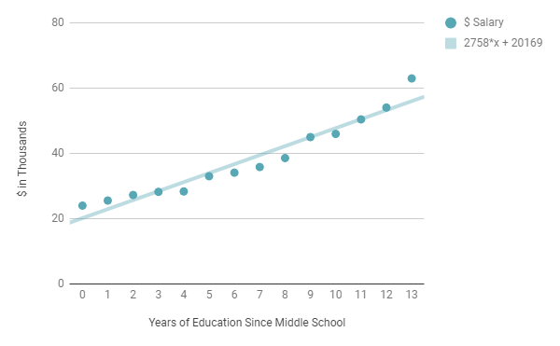
Regression of Salary on Years of Education for Females
Salary vs. Years of Education
Coefficient of 2,758
For every additional year of education, a woman earns $2,758 more in wages all else constant
Notes:
In this fictitious dataset, we collect 14 such comparisons. These are 14 women’s starting salaries, each with varying educational background, plotted here in a 2-dimensional scatter plot.
We also draw the regression line which can be expressed mathematically as the equation: 2758x + 20,169.
X is years of education, and Y is yearly wage. We interpret the coefficient of X, 2758, to mean that for every additional year of education, a woman earns $2,758 more in wages.
This number has many names in regression. It’s called a coefficient, a parameter, or an estimator. We’ll just call it coefficient. If the coefficient of our interest, in this case, years of education, is a non-zero number, then that suggests to us that there might be a causal effect of education on wages.
Why? Because if the coefficient was 0, then the interpretation, is that for every additional year of education, a woman earns $0 more, which suggests that there is no causal effect of education on wages.
Notice any problem with our analysis? Remember, our original question was to answer whether education pays. Not whether education pays for women.
Because we’re after general conclusions that go beyond comparisons between women, we need to look for similar contrasts for men.

Slide 72
Separating on Gender for Within Comparisons
Years of Education | Female Group | Male Group
0 | 24,000 | 22,000
1 | 24,111 | 22,008
2 | 24,535 | 22,658
3 | 25,683 | 24,483
4 | 26,983 | 25,748
... | ... | ...
13 | 67,466 | 57,500
education on wage | Coeff 1 | Coeff 2
Notes:
We need two data sets of wages across years of education, one for each gender, for which we can calculate the causal effect of education on starting salary for each gender.
Let’s call these two, coefficient 1 and coefficient 2. Coefficient 1 is a measure of the causal effect of education for female, and coefficient 2 is a measure of the causal effect of education for male.
Next, we’ll calculate an average of these two coefficients to get one coefficient, to represent the fact that we want an average causal effect of education on wages for all genders.

Slide 73
Regression Conceptually as a Weighted Average Effect
Years of Education | Female Group | Male Group
0 | 24,000 | 22,000
1 | 24,111 | 22,008
2 | 24,535 | 22,658
3 | 25,683 | 24,483
4 | 26,983 | 25,748
... | ... | ...
13 | 67,466 | 57,500
education on wage | Coeff 1 | Coeff2
Causal effect of education on wages
Notes:
While mathematically, what we’ve described earlier (taking an average of coefficients derived from data separated by gender) is not exactly how the regression technique works under the hood, the concept is essentially the same.
A controlled regression makes gender group specific comparisons, then outputs a blended coefficient which has a ceteris paribus interpretation, because the coefficient is derived from the weighted average of gender controlled estimates of the causal effect of education on wages, effectively making it a gender neutral, or controlled effect of education on wages.
Separating data on groups has a causal interpretation if you think about it, because in each group, we are comparing subjects that have the same gender, but different years of education, and we said this is exactly what we wanted to do to disentangle the pure education effect from gender differences. We want all other factors to be held equal, so that the only things that are varying are years of education and wages.
And if you can recall, that’s why we compared Jeannine to Hannah and other women. And similarly, we made sure that men were compared with other men.
A method like regression that works by matching on similar values is called a Matching Method, and the basic idea is this: let’s find people who look the same in our data, but only differ in the treatment variable. That way, we can isolate the treatment variable as the exclusive reason for variation in the outcome variable.
Now if you are running a regression, you don’t have to do it manually, or know what exactly goes on under the hood. Thankfully, we have statistical software that runs the regression for us.
All we need to do is specify a model and the corresponding data.

Slide 74
Accounting for the Unaccounted
Educ
Gender
U
Regression model is another representation of graphical model
Many unaccounted factors lumped into u
Wage
Wage
Effect of education on wages
Effect of gender
Effect of unaccounted factors
Notes:
Here we’re going to specify the regression model both graphically and mathematically. Both are equivalent, although you are probably more familiar with the graphical notation by now.
One addition we will make is that we’ll include a factor labeled, "U", that also affects wages. What is this factor exactly?
Well, remember we assumed that wages are determined by education and gender only, but let’s be real, there’s going to be more to wages than just education and gender like: caliber of school attended, race, geography, ability, and more.
To represent all the unaccounted factors in our regression model that determine wages, we introduce the notation: the letter u, in our model.
At this point, you might be asking, what are we doing? I just want to calculate the causal effect of education on wages? Why do I care about U?
Again, this goes back to the discussion of ceteris paribus. Regression is a way to make other things equal, but it only does so partially, for controls are generated only for variables specified and included on the right-hand side of the model.
That means we only have controls for gender. Failure to include enough of the right controls would leave us with bias. The regression version of the selection bias generated by inadequate controls is called omitted variable bias.
Just to refresh your minds, we covered selection bias in the context of randomized experiments when we said that simply comparing the average health level of the insured and uninsured to derive the causal effect of insurance on health, introduced selection bias because insured people are likely to be more wealthy and educated, therefore heavily biasing the causal link between insurance and health outcomes.
Similarly, omitted variable bias creeps in our regression model when we don't control for all the variables that are relevant to wages, but are correlated with years of education. This is why we had to control for gender when estimating the education premium.
And gender’s certainly not the only variable that we have to control for to get the unbiased causal effect of education on wages. What about ability or family background? What if people who get more schooling are just smarter and come from well to do backgrounds. And that’s why they get higher wages. Maybe school doesn’t really impact wages that much, and it’s actually capturing the effect of ability and family background.
There’s a countless number of omitted variables that are always lurking within this U factor, and the essence of regression is that we’d like to specify them, and have data on them to control for them. This is why we care about U, the group of unknown factors.

Slide 75
Progression of Controlled Regression
Notes:
Notice that we haven’t been very rigid or formal in discussing which variables to include as controls, and that’s because the choice of which controls to include in our model is determined partly by common sense and intuition.
Just as we did with the education-wage example, we started with a base model of wage being solely determined by education, and grouped all other factors into U.
Then we intuited that gender would be a source of bias, which is why we added it to the model as a control.
Then we thought of other possible confounders that we needed to control like family background and aptitude, since making wage comparisons within groups that have similar family background and aptitude, would be more apples-to-apples than they otherwise would be.

Slide 76
How Much to Control for?
Education’s true effect on wages
Impossible to control for everything
Need to do the “best we can”
Admittedly, fairly subjective
X
Y
W1
W2
W?
...
Source(s) of bias many confounders
Notes:
Are we done now?
Well not really. We’d like to capture every important variable that can bias the causal effect of education on wages, but in practice, we cannot observe every single relevant variable. We can’t control for everything, which is what ceteris paribus means: all else equal.
So do we give up on ceteris paribus? Well not necessarily. The key question that every user of controlled regression has to answer is this: have enough key factors been controlled for, or made equal across comparison groups, such that bias from the things we haven’t accounted for is mostly eliminated. This is also called the Unconfoundedness Assumption.
And admittedly, this is really hard to argue and rationalize, because you have to convince yourself and others that you've got the exact correct set of variables that, if controlled for, will actually remove most of the unaccounted variation in confounding variables.

Slide 77
Black, Sandra (1999): Do Better Schools Matter? Parental Valuation of Elementary Education
Answering the question of whether better schools affect house prices?
Are parents willing to pay more for quality education and if so by how much?
Focus on suburbs of Boston
Notes:
Let’s head right into an example of a controlled regression being used in an actual research study.
This study is by the economist Sandra Black, who in 1999, published a famous paper that studied whether housing prices are affected by school quality. The idea is that parents care about their children’s education and therefore, are willing to pay more money for a house that is zoned in a good quality school.
At a first glance at the topic of the paper, a lightbulb should go off in your head. Better schools tend to be located in wealthier neighborhoods, and wealthier neighborhoods usually have amenities like parks, fitness centers, and swimming pools. That means that just looking at the effect of school quality on housing prices would yield a biased result.

Slide 78
If the estimation strategy does not correct for observable and unobservable neighborhood characteristics, potentially correlated both with housing prices and school quality, then the estimation of the marginal willingness to pay for a better school might suffer from severe biases.
Black (1999)
Notes:
In fact, bias is one of the first things the author talks about in the introduction to her paper, and it reads.
If the estimation strategy does not correct for observable and unobservable neighborhood characteristics, potentially correlated both with housing prices and school quality, then the estimation of the marginal willingness to pay for a better school might suffer from severe biases.

Slide 79
First Attempt at Problem: Standard OLS Regression
Coefficient on school test scores is the main focus
Black first uses a “basic hedonic regression” as follows:
Notes:
Black’s first attempt at the problem is a controlled regression of this model structure.
The outcome variable is the home value.
The treatment variable is the average test score of the primary school associated with the district the house is placed.
And the controls are the various characteristics of the house like bedrooms, bathrooms, lot size, internal square footage, as well as neighborhood and school district characteristics.
The causal effect of our interest is this gamma term, the coefficient attached to test score.

Slide 80
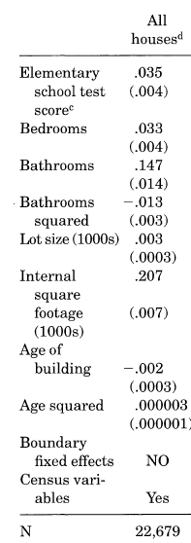
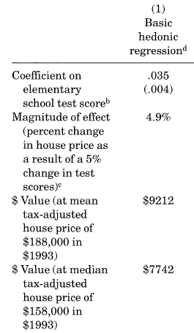
Results from “Basic Hedonic Regression” from Table 2
Causal effect of school quality on home prices
Notes:
These are the results from the controlled regression.
The main finding here is that the magnitude of the test scores coefficient, indicates that a 5 percent increase in the average elementary school test score, is associated with a 4.9 percent increase in the house price, an increase equivalent to almost $9200 at the mean.

Slide 81
Is this Good Enough?
Controlled regressions require good argumentation on the part of the researchers to show that the unconfoundedness assumption holds
Do we have enough controls to ensure that observable and unobservable neighborhood characteristics are controlled for?
Notes:
Is this good enough? Can we run with these results?
Well that depends on whether we believe there are enough controls to ensure that observable and unobservable characteristics which are correlated both with housing prices and school quality are controlled for.
Otherwise, we would have a biased estimate of the causal relationship between school quality and home values.

Slide 82
A drawback to these approaches is that all relevant house or neighborhood characteristics cannot be observed; hence results are biased because of omitted variables.
Black (1999)
Notes:
Black certainly thinks that the controlled regression does not suffice. This is her summary:
A drawback to these approaches is that all relevant house or neighborhood characteristics cannot be observed; hence results are biased because of omitted variables.

Slide 83
Potential Pitfalls of Controlled Regression
Unavailable Features
Features are measurable in theory but not available or hard to quantify
Need to come up with clever proxy variables
Unconfoundedness Assumption
Patently unprovable assumption
Need to come up good argumentation based on established theory
Included Variable Bias
Function of bad multicollinearity with treatment variable and also carelessness
Model Specification
Extent to which omitted variable W is correlated with X will affect how much multicollinearity will act to increase the standard errors on the regression coefficient for X.
Notes:
As we did before with randomized experiments, we’ll note some potential downsides to using controlled regression.
A big pitfall in regression is that confounders are often unobservable .
Either because the variables are measurable in theory but are not available (like health information which is often safeguarded by hospitals due to privacy rules), or because the variables are hard to quantify (like attractiveness or sociability). Whichever the case, often the best we can do with regression is to proxy for those unobservables with whatever data we have access to. For example, we might very well have access to SAT scores and parental income which, while not perfect, could be a good estimate or proxy for aptitude and family background. Therefore, regression requires some cleverness on our part to come up with creative variables that serve as good proxys for the variables that we want to control for.
Another pitfall is that sometimes we might get too eager about controlling for variables, that we unknowingly control the treatment variable. This is the problem of included variable bias. As an example, the journalist, Ezra Klein, wrote in an issue on Vox.com, that most gender wage gap studies try to control for so many things, that they end up controlling for the thing they are trying to measure.
Klein uses the example of hours worked, which is a standard control in wage gap studies. Note that because women tend to work fewer hours than men, if a study controls for hours worked, then some of the gender wage gap would disappear, since women work shorter hours because they are usually assigned the bulk of childcare responsibilities.
Controlling for hours worked, in other words, is at least partly controlling for how gender works in our society. It’s controlling for the thing that should actually be allowed to vary. The lesson? We have to be pretty careful about what we control for.

Slide 84
Further Studies on Regression
Using Social Security Data on Military Applicants to Estimate the Effect of Voluntary Military Service on Earnings
Angrist (1998)
Introductory Econometrics: A Modern Approach
Wooldridge (2015)
Estimating the Payoff to Attending a More Selective College: An Application of Selection on Observables and Unobservables
Dale et Krueger (1999)
Mostly Harmless Econometrics
Angrist et Pischke (2009)
The Causal Effect of Education on Earnings
Ashenfelter et Card (1999)
Notes:
The controlled regression is a pretty timeless technique that has a lot of resources devoted to its study.
If you want to learn more about regression, these are the resources I recommend.

Slide 85
Instrumental Variables
Finding the source of exogeneity to resolve OVB
Notes:
With regression, we had to use some intuition, theory, and common sense to figure out what controls needed to be added into our model. Otherwise, we knew we would get a causal effect that suffered from omitted variable bias.
Thankfully though, there is another causal inference technique called instrumental variables analysis in our toolbox, that controls for confounding variables, without having to specify all of them like we had to do in regression. Let’s take a look at it in the next lesson.

Slide 86
Toolbox
Randomized Experiment
Instrumental Variables
Regression (Controlled)
Notes:
Instrumental variables analysis is the 3rd causal inference technique we will cover.

Slide 87
Four Scenarios
If W is related to both X and Y?
If W is unrelated to both X and Y?
If W is related to X but unrelated to Y?
If W is unrelated to X but related to Y?
Notes:
Consider the familiar example, where we have a regression of Y on X, with W representing omitted variables. And we want to figure out the causal impact of X on Y.
Let’s take a look at four hypothetical scenarios to see if any one of them can address the omitted variable bias.

Slide 88
W is Related to Both X and Y
X
Y
W causes Y and W has a correlation with X
The very definition of omitted variable bias
W
Notes:
The first scenario is when W is related to both X and Y.
This structure should look very familiar, since we covered it many times from earlier modules. This is precisely the case where we have omitted variable bias. We want to include W, if we have data on it, because by including W, we reduce bias due to its omission.
Since we often don’t know what W is, we don’t like this scenario.

Slide 89
W is Unrelated to Both X and Y
X
Y
W is independent of the process between X and Y
Keep W omitted (don’t include in regression)
W
Notes:
Next, let’s consider the case where W is unrelated to both X and Y. In other words, W is not connected in any way to the model. Therefore, in this scenario, we don’t have any omitted variable bias, and we like this regime because we don’t have to do anything. W is unknown, and that’s fine, since it has nothing to do with the model.

Slide 90
W is Related to X but Unrelated to Y
X
Y
Bad case of multicollinearity
X contains all the information we need to explain Y.
W is redundant as it is independent of Y conditioned on X (chain)
W
Notes:
Next, let’s consider the case where W is related to X, but unrelated to Y.
This is what social science researchers would call, a bad case of multicollinearity, and we don't like that.
You can basically think of it like this.
X carries all the information it needs to explain Y.
Therefore, W is redundant, since X is already included in the regression. We want to keep W omitted.

Slide 91
W is Unrelated to X but Related to Y
X
Y
Want to include W if we have data on it for better prediction
Won’t reduce any bias of the causal relation between X and Y (note: no OVB)
W
Notes:
And finally, let’s consider the case where W is unrelated to X, but related to Y.
Here, there is no omitted variable bias since there is no correlation between W and X.
If we have data on W, great, we should include it, since its inclusion will help us model, and predict Y better.
But if we don’t, that’s OK, since including W won’t reduce bias.

Slide 92
Ideal Scenarios in Regression
If W is related to both X and Y?
If W is unrelated to both X and Y?
If W is related to X but unrelated to Y?
If W is unrelated to X but related to Y?
Notes:
In summary, we like two of the four scenarios we covered, and it turns out that instrumental variables analysis is going to help create one of these scenarios.

Slide 93
What Makes a Proper Instrumental Variable?
Exclusion Restriction
Z
X
Y
Relevance
Exogeneity
Cov(Z,W) = 0
Relevance (Strong first stage)
Cov(Z,X) ≠ 0
Exclusion Restriction (follows from exogeneity and relevance)
Z ⇒ X ⇒ Y
Z is conditionally independent on Y given X (chain)
Exogeneity
W
Notes:
It’s at this time that we are fully prepared to discuss instrumental variables, and see how the graphical structure of an instrumental variables analysis, fits in with one of the 2 ideal scenarios we covered earlier.
Recall that we are trying to estimate the causal effect of X on Y, but cannot just take the raw correlation as causal, because there are omitted variables.
For simplicity, let’s lump them all into W.
An instrumental variable, or instrument for short, is a feature or a set of features, Z, such that the following assumptions are met:
First, the exogeneity assumption. Basically, what this assumption is saying is that there is no relationship between Z and W.
This is why we marked the link between Z and W with a red mark
Second, the relevance assumption, also called the strong first stage assumption. What this means is that there is strong causal relationship between Z and X.
And that is why we have an arrow pointing from Z to X.
And finally, the exclusion restriction, which states that Z affects the outcome variable, Y, only through its effect on X, meaning that the instrument does not have a direct influence on Y.
If all of these requirements are met, Z is a proper instrument.

Slide 94
How to Make This More Familiar to Our “Ideal Scenario”
The scenario we want to rid of OVB: W is unrelated to X but related to Y
Solution: Capture the portion of X that is only explained by Z
Denote this portion as X’
Z
X
Y
W
Notes:
Tidying up our earlier graphic, we have this. This is how the instrumental variables analysis looks in graphical representation.
The intuition of the instrumental variable Z is that variation in Z, causes variation in X, without affecting the variation in W.
How do we know this? Because of the exogeneity assumption.
What this means is that we can calculate the portion of the variation in X, that is exclusively caused by variation in Z, and uncorrelated with W.
We’ll use the notation X prime, to denote the portion of X that is unaffiliated with W.

Slide 95
How IV Analysis Addresses the OVB Problem
X’ is the portion of X that is independent of W (no relationship)
X’ is the predicted values of X provided just Z
Z
X’
Y
W
Notes:
To summarize, an instrumental variables analysis involves using an instrumental variable Z, which is correlated with X, but uncorrelated with W.
The effect of this is that we are able to break X into two parts: a part that is correlated with W, and a part that is not. By isolating the part that is not correlated with W, we get X prime, which we can use to calculate the pure causal effect of X on Y, and not the effect of X on Y that is confounded by W.

Slide 96
Methodology: Two-Stage Least Squares (2SLS) Regression
1st stage
2nd stage
Stage 1: Regress X on Z and obtain predicted values of X
Stage 2: Regress Y on predicted values of X, and obtain the 2SLS estimator
Z
X’
Y
W
Notes:
So how do we do the instrumental variables analysis in practice?
Before we do anything, it’s important to note that the most crucial step of instrumental variables analysis, is reasoning that the instrumental variable satisfies the three requirements: Relevance, Exogeneity, and exclusion restriction.
Once that’s done, we run what is called a two-stage least squares regression, and it’s called by this name because there’s two stages of regressions we have to run.
The first stage involves the regression of X on Z. The interpretation? We want the portion of X that is solely explained by Z.
We called this, X prime.
Running the first stage regression can give us the predicted values of X, solely attributed to just Z; this is the same of getting just the variation in X, attributed to variation in Z.
The second stage involves the regression of Y on the X prime that we derived from the first stage. The interpretation?
Well, the coefficient on X prime is the magnitude of the causal effect of X on Y that we are looking for. This coefficient is also called the two stage least squares estimator.
Intuitively you can think of two stage least squares regression as like crossing two bridges: the bridge from Z to X, and the bridge from X to Y.

Slide 97
Acemoglu, Daron et al. (2001): The Colonial Origins of Comparative Development
Acemoglu and colleagues wanted to estimate the effect of institutions on economic performance
Institutions are not exogenous (randomly assigned)
Notes:
As we did before with other causal inference techniques, let’s head right into a real world example.
Acemoglu, and colleagues who are authors of the paper, The Colonial Origins of Comparative Development, wanted to study the impact of institutions on economic performance. By institutions, they meant things like property rights.
They wondered whether having property rights were major determinants of economic performance, and key factors in understanding the vast cross-country differences in wealth.
As institutions were not randomly assigned to countries, they were wary of biased estimates. Their solution? Look to history for natural experiments.

Slide 98
Underlying Assumptions of the Study
Potential settler mortality
Settlements
Early Institutions (17th, 18th century)
Current Institutions
Current Economic Performance
Notes:
What the authors looked to was the history of European colonization. They noted that historically, in some colonies, European settlers faced very high death rates because of diseases for which they had no immunity. Where settler mortality was high, the Europeans did not settle, and the colony was governed by an authoritarian state with the strict purpose of maintaining control and extracting natural resources and slave labor.
Where settler mortality was low, the Europeans raised their families and settled, and the colony was modeled after the home country, which meant that those settler colonies had representative institutions which promoted freedoms like property rights.
The researchers theorized that those past institutions that were set up by colonists, persisted into modern day institutions, even after independence.

Slide 99
Settler Mortality as an IV for Institutions
Exclusion Restriction
Settler mortality (Z)
Institutional quality (X)
Economic performance (Y)
Assumption check?
Z
X
Y
Relevance
Exogeneity
W
Notes:
Given these qualifications, the researchers used an instrumental variables analysis with the instrument being settler mortality, to address omitted variable bias.
To show that settler mortality was a proper instrument, the authors made arguments for why the three assumptions were met.
First, the relevance assumption. Does settler mortality meaningfully affect today’s institutional quality of countries? The authors argued that places with lower settler mortality in the colonial era, actually implied that those countries had higher property rights in the year 1995.
Second, the exogeneity assumption. The authors argued that the fact that some parts of the world, hundreds of years ago had higher risk of disease, was unrelated to other factors that would affect GDP in the year 1995.
And third, the exclusion restriction. The authors argued that settler mortality did not directly affect GDP in 1995. And that seems plausible, because GDP today probably doesn't depend directly on whether settlers were dying in the year seventeen hundred. What’s more plausible is that settler mortality affected early institutions which persisted over hundreds of years.

Slide 100
2SLS Procedure
2SLS estimator (causal effect of institutions on economic performance)
Settler mortality
Latitude, continent, temperature, humidity, natural resources...
Protection against expropriation measure
Notes:
After explaining the legitimacy of the instrument, the researchers use a two stage least squares regression to find the causal effect of institutions on economic development.
Note that the authors use a variable called the average protection against expropriation risk as a proxy for institutional quality, and the GDP as a proxy for economic development.

Slide 101
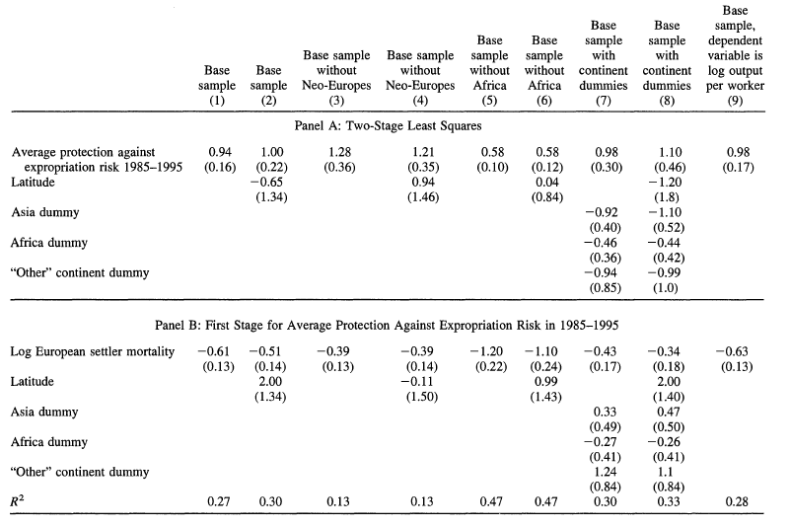
2SLS Results
>0 and statistically significant
Notes:
This is the results table from the two stage least squares regression.
In Panel B, the bottom area of the table, we can see the results from the first stage regression.
The main finding in Panel B, is that the coefficient on settler mortality is -0.61, indicating a negative relationship that we had intuited before when discussing whether the relevance assumption holds.
In Panel A, the top area of the table, we can see the results of the 2nd stage regression. The main finding here is 0.94, the coefficient on average protection against expropriation risk. This number is an estimate of the true causal effect of institutional quality on GDP. Because it is positive and statistically significant, the authors conclude that there is indeed a true causal effect of property rights on economic development.

Slide 102
The validity of our 2SLS results in Table 4 depends on the assumption that settler mortality in the past has no direct effect on current economic
performance...
Acemoglu et al. (2001)
Notes:
And lastly, the researchers add a qualifier that none of the results matter if the assumptions in an instrumental variable analysis are not met.

Slide 103
Is this Good Enough?
Results are contentious; arguments for or against the results are centered on whether the IV assumptions are met
Most of the paper is devoted to telling the story of why the authors think the assumptions are valid
Notes:
Before we move on from this study, I’ll just quickly note that this paper is quite contentious.
You will find that contention is a pretty common theme in studies using instrumental variables analysis, because two of the requirements for an instrument to be proper are impossible to prove, meaning that no matter how much data we have, we cannot prove them.

Slide 104
Potential Pitfalls of IV Analysis
Unprovable Assumptions
Arguing for the exogeneity and exclusion restriction requires solid argumentation and theory (no empirical work will do)
Strong Relevance
Needs to be strong correlation in the first stage; otherwise potentially a lot of bias
Interpretation
If the instrument only assigns a narrow group in the population to treatment and control, then estimator is LATE (local average treatment effect)
Estimates are biased but consistent
BIas from IV estimation can actually be worse than bias from OLS in finite samples (need “a lot” of data)
Especially the case if the estimator is weak (weak first stage)
Notes:
These two requirements that are patently unverifiable are exogeneity, and the exclusion restriction.
The exogeneity assumption states that the instrument and confounding factors are not correlated: This one is impossible to test since confounding factors are never observable. This is why researchers will have to rely on good theories and argumentation to say that the exogeneity assumption holds.
Then there is the exclusion restriction assumption, which states that there is no direct causal pathway from the instrument to the outcome variable. This assumption is also impossible to test, since it involves seeing the true model structure of which we never get to see.
To motivate the exclusion restriction, we also need to rely on theoretical foundations to think about all the possible relationships between the instrument and the outcome. If the instrument affects the outcome through any other channels than the treatment variable, then the instrumental is not valid.
In summary, the bad news is that good instruments are hard to find, because they have to satisfy three assumptions, two of which are impossible to corroborate empirically.
But here’s the good news, a good instrument, if we can find it, allows us to estimate the causal effect of the treatment variable on the outcome variable, free of omitted variable bias, without having actual data on the omitted variables.

Slide 105
Further Studies on Instrumental Variables
How Large are Human-Capital Externalities? Evidence From Compulsory Schooling Laws
Acemoglu et Angrist (2001)
Do Institutions Cause Growth?
Glaeser et al. (2004)
Instrumental Variables Methods in Experimental Criminological Research: What, Why, and How?
Angrist (2005)
The Oregon Health Insurance Experiment: Evidence From the First Year
Finkelstein et al. (2011)
Notes:
If you want to learn more about instrumental variables analysis, these are the resources I recommend. These papers will give you many examples of different instruments, and reasons for why they are good instruments.

Slide 106
Regression Discontinuity
Looking near a cutoff for a local randomized experiment
Notes:
The next causal inference technique we’ll cover, is called regression discontinuity.

Slide 107
Toolbox
Randomized Experiment
Instrumental Variables
Regression (Controlled)
Regression Discontinuity
Notes:
This is the penultimate causal inference technique in our toolbox, so let’s finish strong.

Slide 108
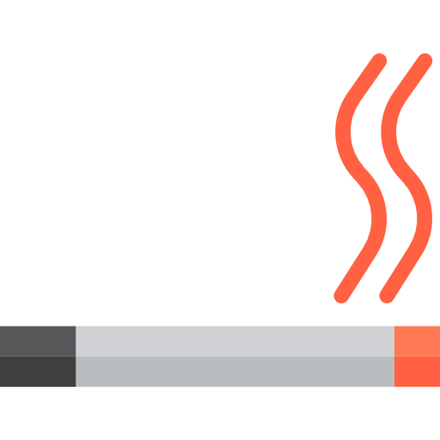
Looking at the Cutoff
Basic idea is that policy rules vary at some cutoff point
Whether you are eligible for a program
Which school district you reside in
Whether you are of legal age to drink
Whether you pass a university course
Notes:
In the world, there are many thresholds which yield binary outcomes.
For example, if you are 21 or above in the United States, you can purchase alcohol legally. Otherwise, you cannot.
When you are 16 or above in the United States, you can drive legally. Otherwise, you cannot.
In most grading schemes in universities, scoring a 59 or below is a failing score, and anything above 59 is a passing score.
The key insight of regression discontinuity design is this.
Aren’t the people right around the threshold more or less equivalent?

Slide 109
Pass Fail Cutoff in University
<59 is a fail in university
Person A who scored 58.9 fails the course
Person B who scored 59.1 passes the course
Person A ≈ Person B (ceteris paribus?)
Notes:
For example, what really is the difference between a student who scores a 59.1, and a student who scores a 58.9.
Sure, one gets a passing grade and the other doesn’t get a passing grade, but besides that, can we realistically imagine these two people to be different? After all, their score differences are only 0.2.
The regression discontinuity technique is based on this assumption that there’s really no systematic difference between the people who are just below and above the cutoff.

Slide 110
Thistlewaite, Donald, Donald Campbell (1960): Regression-Discontinuity Analysis: An Alternative to the Ex-Post Facto Experiment
Paper introduced regression discontinuity design into mainstream research
Does scholarship improves student achievement after school?
Notes:
The best way to understand regression discontinuity, is to go straight into a real life example.
In 1960, researchers Thistlewaite and Campbell did a study to figure out whether scholarships had any effect on student achievement after school.
In their study, the scholarship they focused on was the national merit scholarship, which required students to take a test. If they scored above a certain cutoff, they received a scholarship, and if they didn’t, they received no scholarship.

Slide 111
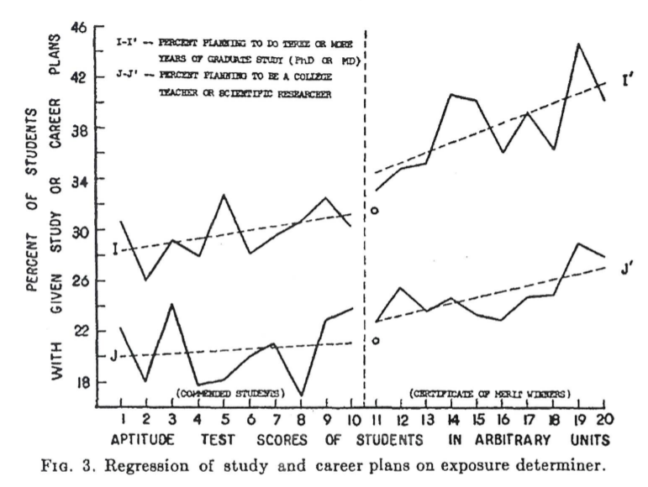
Regression of Study and Career Plans on Test Score
Receive control
Receive treatment
Notes:
This graph is from their original paper from 1960. We have in the X axis, the test scores.
And on the Y axis, we have the percentage of students with given study or career plans. This is their proxy variable for student achievement. In the study, the researchers highlighted two types of outcomes. People pursuing three years or more of graduate school, and people planning to become a professor or scientific researcher. Their percentages are shown in the Y axis.
Now let's look at the regression discontinuity idea. The basic idea is that the people who are just below the scholarship cutoff of 10.5, are essentially the same people as the people who are just above the cutoff: that is their receiving scholarship was not because of any systematic difference.
If we believe in this assumption, then any difference in the average outcomes between these two groups of people, is solely attributed to the treatment of receiving a scholarship.
Looking at Thistlewaite and Campbell’s graph, we can see that there is a jump and a discontinuity in the regression line. It seems that people who get the scholarship do go on to pursue more education or a career in scientific research at a slightly higher rate.
Now admittedly, the data is a bit noisy, which is why the researchers drew a regression line on both sides of the cutoff, to make it more distinct that there is a bump in student achievement due to the scholarship.
But don’t let the regression lines fool you. We are not comparing the have’s and have not’s. We are comparing the almost have’s, and the almost have not’s.
Why? Because it's only once we look close to the cut-off, that students would be near equivalent in all observed and unobserved characteristics, such that confounding variables are no longer an issue, and treatment status becomes more or less randomly assigned.

Slide 112
Regression Discontinuity Design (RDD) Options
Nearest neighbors (fixed bandwidth)
Distance kernel
Interpolation (regression)
Notes:
Ok, so how do we actually run the regression discontinuity design?
Broadly speaking, there’s 3 common ways.

Slide 113
Nearest Neighbors
RDD w/ Fixed Bandwidth of Size 3
35
30
Create a fixed bandwidth of size M and average the outcomes of those K neighbors that fall within the bandwidth
25
20
Arbitrary Units of Outcome Variable
15
Receive control
Receive treatment
10
5
0
0
2
4
6
8
10
12
14
Arbitrary Units of Running Variable (≥7=Treatment)
Notes:
The first method is called nearest neighbors. Here, we are going to draw a small bandwidth to the left and right of the cutoff, and take the nearest neighbor of points that fall within. Then we take a simple average of these two groups and compare the averages. This is our treatment effect.
How large our bandwidth should be depends on the context. And it’s a tradeoff that you have to figure out. The smaller the bandwidth, the more likely it is that the treatment assignment becomes random, but we won’t be picking up much data points. And statistics will tell us that the more data points we have, the more we can be confident about a sample statistic. But at the same time, the more we increase the bandwidth, the higher the chance that we are picking up the confounding effects of higher test scores.
So the tough question you have to answer is, how close is close? How do we balance getting more data, vs. looking close to the cutoff.

Slide 114
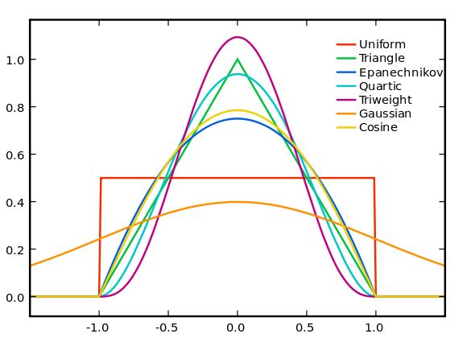
Distance Kernels
Popular Kernels in Empirical Methods
The weight of each point falls off as as a function of its distance from the cutoff
Kernels specify how the weights decay
Simple average uses a uniform kernel
Notes:
The second method is using what’s called a distance kernel. And the idea of the distance kernel is that we want to look at many more points than we can, with a narrow bandwidth from the nearest neighbors method, but because in doing so we sacrifice locality and expose ourselves to confounding variables, we want to weight points which are far from the cutoff, much lower than points which are close to the cutoff.
So you can think of this method as trying to get the best of both worlds. With distance kernels, we can factor in more points than we can with just a small narrow window near the cutoff, but also try to prevent the influence of confounders by putting much more weight on the points near the cutoff.
This graphic shows the most commonly used kernels.
The Y axis you can think of as the weights, and the x axis you can think of as distance from the cutoff.
Note that each kernel has a different way of assigning weights. Some taper off really quickly, whereas others are really smooth.

Slide 115
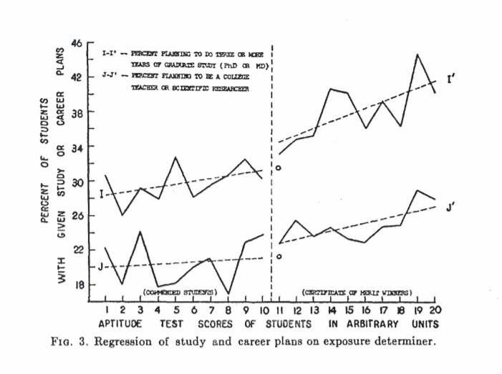
Interpolation (Regression)
Figure 3. From Thistlewaite et Campbell (1960)
Regress on the left and right hand side of the cut off
Then calculate the height difference between the two trends
Notes:
The third method is what Thistlethwaite and Campbell did in their research.
Basically we do a regression on the left-hand and right hand side of the cutoff. Then calculate the difference between the two fitted points at the cutoff. This is our treatment effect.

Slide 116
Sharp RDD vs. Fuzzy RDD
Fuzzy RDD Design
35
30
Sharp RDD
Discontinuity of treatment (an all or nothing situation)
Fuzzy RDD
Discontinuity of the probability of treatment (higher probability above cutoff)
25
20
Arbitrary Units of Outcome Variable
15
Lower probability of treatment
Higher probability of treatment
10
5
0
0
2
4
6
8
10
12
14
Arbitrary Units of Running Variable (≥7=High Probability of Treatment)
Notes:
At this time, I want to point out that what we have described thus far is called a sharp regression discontinuity design. Basically, it’s an all or nothing situation. You either receive the treatment if you are above the cutoff, or don’t receive the treatment if you are below the cutoff.
One other thing you should note is that there is also something called a “Fuzzy Regression Discontinuity”, and this occurs when rules are not strictly enforced.
For example, perhaps the scholarship from our previous example is not solely determined by SAT scores, but students above the cutoff get a higher chance of receiving the scholarship than those below it. Therefore, the threshold here is fuzzy. It concerns a discontinuity of the probability of receiving treatment. This means that students above the threshold may not receive the scholarship, and those below the threshold may receive the scholarship.
Fuzzy regression discontinuity problems can therefore be solved using instrumental variables analysis. If this is hard to imagine, convince yourself of this by revisiting the module on instrumental variables and going through the three assumptions which need to be met for an instrumental variables analysis. Fuzzy regression discontinuity is one form of instrumental variables analysis.

Slide 117
Black, Sandra (1999): Do Better Schools Matter? Parental Valuation of Elementary Education
Remember this study from the regression module?
Trying to measure the effect of school quality on home values
The main results of the paper actually come from implementing RDD
Notes:
We are going to revisit Sandra Black’s paper, Do Better Schools Matter? Parental Valuation of Elementary Education.
If you can recall, we covered this paper in the regression module.
We noted then that Black’s first approach at the problem used a controlled regression to find out the effect of school quality on home values, and found that the magnitude of the test scores coefficient, which was a proxy for school quality, indicated that a 5 percent increase in the average elementary school test score was associated with a 4.9 percent increase in the home value, an increase equivalent to almost $9200 at the mean home value.
But Black also thought that the controlled regression did not suffice, because she couldn’t control for all relevant house and neighborhood characteristics, which biased her estimate of the impact of school quality on home values.

Slide 118
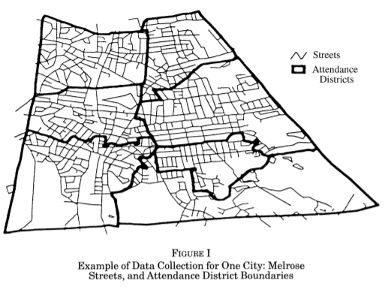
RDD Strategy: Look at Houses Near the District Boundaries
Figure 1: Example of District Boundary
Look at schools near the school district boundaries
Why? Homes near the boundaries are going to be very similar but zoned to go to different schools
Notes:
Black uses the regression discontinuity approach to remove the effects of confounders.
In the United States, children go to the school based on the location of their home. There are attendance zones which demarcate the homes which are designated for a particular school.
And basically, the idea of Black’s study was to compare houses on opposite sides of a common primary schooling attendance district boundary. The assumption she makes is that changes in school quality are discrete at boundaries, while changes in neighborhood characteristics are smooth, meaning that unobservable neighborhood characteristics correlated with test scores are the same on each side of the border.
Therefore, comparing home values of two families who live in opposite sides of the same street, but are zoned to go to different schools, would be a good estimation of people’s willingness to pay for school quality. Black describes this as the marginal willingness to pay for a better school.

Slide 119
If neighborhoods change continuously over space, by looking at houses very close to attendance district boundaries-where there is a discrete change in school quality—I can avoid the pitfalls associated with omitted neighborhood characteristics.
Black (1999)
Notes:
And this is in her words, why regression discontinuity would be useful for this problem.
If this assumption is correct, then difference in mean home values located on opposite sides of attendance district boundaries can be attributed to the differences in primary school exam scores only.

Slide 120
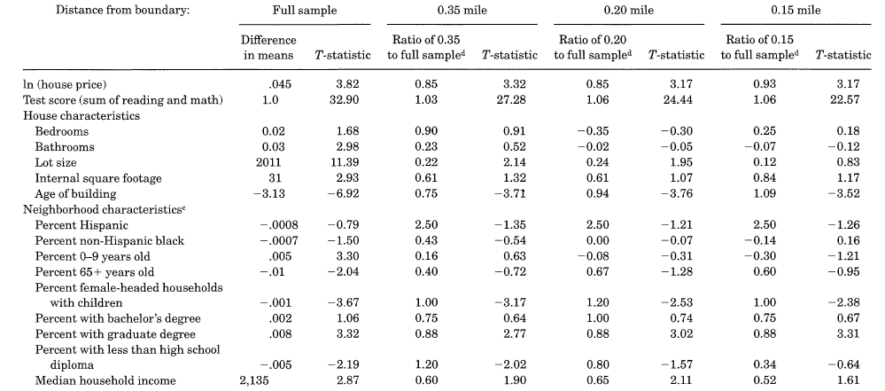
Confirming that Houses Near the Boundaries are Similar
Notes:
Researchers will try to confirm their assumptions if they can. This is Table III from Black’s paper, which shows that houses on opposite sides of the boundary do become similar, when the sample is reduced to houses that are close to the boundary.

Slide 121
Methodology: Calculate Means on Opposite Sides of the Border
Black uses a regression based approach
Focus of the study
Notes:
What Black uses to calculate the causal effect of the average test score on the home value is a regression of this structure.
And it’s important to note here that this regression is not the same as a controlled regression we discussed in an earlier module, and Black makes this clear by stating that her methodology is equivalent to calculating differences in mean house prices on opposite sides of attendance district boundaries.
The treatment variable here is the average test score of the school associated with the district the house is placed. Therefore, the coefficient represented by the greek letter, gamma, is the focus of the study.
Black also keeps her original controls from what she called the hedonic regression model, more or less the controlled regression model that she used as her first attempt at cracking the problem. These controls are number of bedrooms, bathrooms, and neighborhood and school district characteristics that will help us move towards ceteris paribus even more.

Slide 122
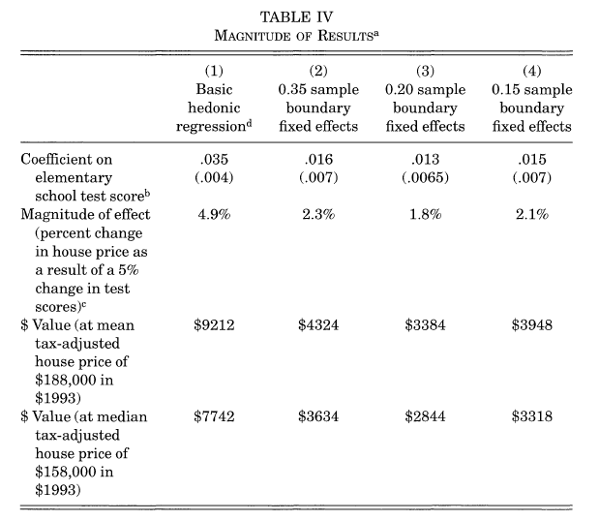
What the Results Mean in Dollars
3.1% without RDD (not comparing houses on opposite sides of the school district line)
1.5% treatment effect with boundary fixed effect (RDD)
Notes:
These are the results and the key thing to note is this. The coefficient, gamma, of elementary school test score in column 5, the number 0.031, was the result Black got from the basic hedonic regression, remember just the controlled regression.
But the coefficient for the regression discontinuity model, which she labels as, with boundary fixed effects, the number is 0.015, roughly half. The interpretation?
The naive estimation using the controlled regression was a pretty biased estimate. If we do not carefully control for neighborhood characteristics, we would be greatly overestimating the value of additional school quality as measured by test scores.

Slide 123
Using an approach that compares houses that are close to each other but are associated with different elementary schools, I find that parents do care about school peers and other unmeasured components of school quality. As such they are willing to pay about 2.1 percent—or $3948—more for houses that are 5 percent higher at the mean.
Black (1999)
Notes:
The conclusion? Black writes that parents do care about school quality as proxied by the the elementary test scores.
The measured effect. Parents are willing to pay about 2.1 percent, or $3948 more for houses that are 5 percent higher at the mean.

Slide 124
Potential Pitfalls of RDD Studies
Sample Size & Bandwidth
Sample size is usually small near the cutoff, and it’s sort of ambiguous how to choose the bandwidth
Confounding Discontinuities
Other rules changed at the cutoff we are unwary of
Manipulation
Subjects if they know they can receive a benefit if they reach above a certain threshold can manipulate into being treated
External Validity
LATE estimator that pertains to people in a narrow or local range around the cutoff
Notes:
While regression discontinuity is very intuitive and often really nice, there are a couple potential issues that we have to be wary of.
The first is one we’ve covered. That the sample size is usually not very big at the threshold, and it’s really ambiguous how we go about choosing a good bandwidth. We want to reduce unobserved differences between the two groups, but at what cost.
The second problem is that there may be other rule changes happening at, or near the same threshold. Referring to Thistlewaite and Campbell's study, if students who get a score above the threshold, and get a scholarship, and on top of that, receive other benefits, like the chance to study abroad, or apply to fellowships, the effect we would estimate would be the combined causal effect of getting the scholarship, the chance to study abroad, and apply to fellowships, and not simply the causal effect of receiving the scholarship alone.
The third problem is that regression discontinuity designs can be invalidated if people manipulate the treatment assignment. As long as subjects can’t manipulate which side of the threshold they end up on, we can treat the assignment as random. However, if students know that they can receive a benefit if they reach above a certain threshold, they can effectively “choose” their way into the treatment.
One way to test for this, is by checking whether the people just below the cutoff, are similar to the people just above the cutoff; if there are more people on one side than the other, individuals may be controlling their assignment.
The fourth is the concept of external validity. In regression discontinuity, we’re estimating what is called a local average treatment effect. The effect pertains to people in a narrow, or “local” range around the cutoff. If there are different treatment effects for different types of users (also called heterogeneous treatment effects), then the estimates may not be broadly applicable to the full group.

Slide 125
Further Studies on Regression Discontinuity
Evaluating the Worker Profiling and Reemployment Services System Using a Regression Discontinuity Design
Black et al. (2007)
Economic Impacts of New Unionization on Private Sector Employers
DiNardo et Lee (2004)
Using Maimonides’ Rule to Estimate the Effect of Class Size on Student Achievement
Angrist et Lavy (1997)
Waiting for Life to Arrive: A History of the Regression Discontinuity Design in Psychology, Statistics and Economics
Cook (2008)
Regression Discontinuity Designs: A Guide to Practice
Imbens (2007)
Notes:
If you want to learn more about other studies which use regression discontinuity, these are the resources I recommend.

Slide 126
Difference-in-Differences
Finding causality using parallel trends
Notes:
In this module, we’ll cover the causal inference technique difference in differences.

Slide 127
Toolbox
Randomized Experiment
Instrumental Variables
Difference-in-Differences
Regression (Controlled)
Regression Discontinuity
Notes:
Finally, the fifth causal inference technique in our toolbox, difference-in differences. Let’s finish strong.

Slide 128
Intuition of Difference-in-Differences (DD)
Treatment effect
Observed change in outcomes over time for treated
Outcome
Unobserved counterfactual for treated
Constant difference in outcome
Observed change in outcomes over time for control
Pre-intervention
T
Post-intervention
Notes:
Difference in differences, is a causal inference technique that works with panel data. Panel data just means that the data has a time component, and stretches over at least two periods of time.
The method requires data measured from a treatment group and a control group at two or more different time periods, specifically at least one time period before "treatment", and at least one time period after "treatment." In the example pictured, the treatment group is represented by the orange line, and the control group is represented by the blue line.
The outcome in both groups, are initially measured at some point before the treatment period. Let’s just call this the pre-intervention point.
The treatment group at time T, then receives or experiences the treatment, and both groups are again measured at some point after the treatment period. Let’s call this the post-intervention point.
Note that not all of the difference in outcome, between the treatment and control groups at the post-intervention point, can be explained as being an effect of the treatment, because the treatment group and control group did not start out at the same level at the pre-intervention point.
The difference in differences technique therefore deducts from this total difference, the difference that would exist if neither group experienced the treatment, represented by the constant difference in outcome.
Notice that the slopes, or trends of the orange line and the blue line are equal. And this is the key assumption underlying difference in differences.
The parallel trends assumption, which says that the treatment group and the control group in the absence of treatment, follow the same trend and therefore, the difference between the ‘treatment’ and ‘control’ group in the absence of treatment is constant over time.
What follows from the parallel trends assumption is that any deviation of the treatment group’s trend, post-intervention, from pre-intervention, is solely attributed to the treatment.

Slide 129
Example of DD Calculation
DD Table
A2
 | After | Before | Difference
Treatment | A2 | A1 | A2-A1
Control | B2 | B1 | B2-B1
Difference | A2-B2 | A1-B1 | (A2-A1)-(B2-B1)
Treatment effect
B2
Outcome
A1
B1
Pre-intervention
T
Post-intervention
DD estimate of causal effect
Notes:
To apply difference in differences, all that is necessary is to measure outcomes in the treatment group and the control group both before and after the treatment.
The difference in differences is a simple difference between two differences. Hence the name difference in differences.

Slide 130
Visualizing When DD Fails
True counterfactual
Treatment group
DD estimate
Bias
Outcome
Control group trend
Control group
Pre-intervention
T
Post-intervention
Notes:
It is important to note that the counterfactual being estimated here, is the change in outcomes for the control group. This means that when we use the difference in differences technique, the treatment group and the control group do not necessarily need to have the same pre-intervention conditions. But for difference in differences to be valid, the control group must accurately represent the change in outcomes that would have been experienced by the treatment group in the absence of treatment.
This figure illustrates a violation of the parallel trends assumption, and therefore a misuse of difference in differences. If outcome trends are different for the treatment and control groups, then the estimated treatment effect obtained by difference in differences methods would be biased.
The reason is that the trend for the control group is not a valid estimate of the counterfactual trend that would have prevailed for the treatment group in the absence of the treatment.
As we see in the figure, outcomes for the treatment group grow faster than outcomes for the control group in the absence of the treatment, so using the trend for the control group as a counterfactual for the trend for the treatment group, leads to an overestimation of the treatment’s impact.

Slide 131
Intuiting the Point of DD With Simple Policy Analysis
Policy analysts often use pre-post analysis to determine the effect of a policy (e.g. What’s the effect of raising the minimum wage?)
Randomly sample low-wage firms and measure employment before minimum wage increase, then again after minimum wage
What’s wrong with this?
Notes:
Policy analysts often use what’s called a pre-post analysis to determine the effect of a new law.
For example, the state of New Jersey would like to quantify the impact of a new minimum wage law on unemployment rates. And so they might simply sample some low-wage firms like fast food restaurants that would be affected by the minimum wage law, and measure employment before the minimum wage increases, and then at some point again after minimum wage increases.
This is the gist of a pre-post analysis. Measure the outcome before the treatment, and then again after the treatment. Then take the difference as the treatment effect.
At this point, we’re so attuned to what’s wrong with such a simple before and after analysis.
For example, what if something else changes as the minimum wage law changes.
What if there is a Federal law that reduces taxes on businesses.
What if there is a recession, or an oil shock.
You can imagine there being a lot of things going on that confounds the relationship between New Jersey's minimum wage law, and the unemployment level in New Jersey. Any of these changes and events, if not controlled for, would bias the results of the policy change of interest.
Is there any way (other than controlling all possible things that might change simultaneously with minimum wage law) we can deal with this problem?
It would be nice if we had a control group, a group of similar entities existing under similar circumstances that didn’t experience the minimum wage increase. One that exhibits common or parallel trends. Sound familiar?

Slide 132
Card, David, Alan B. Krueger (1994): Minimum Wages and Employment: A Case Study of the Fast-Food Industry in New Jersey and Pennsylvania
Intervention: New Jersey’s minimum wage increase in 1992
Treatment group: fast food restaurants in New Jersey
Control group: fast food restaurants in Eastern Pennsylvania
Notes:
In 1994, the economists Card and Krueger published a famous paper that studied this exact same question of whether a change in minimum wage laws in New Jersey affected unemployment. What Card and Krueger used was the difference in differences technique.
Note that the ideal experiment would let us observe New Jersey at one point in time, simultaneously in 2 states of the world
The state with no minimum wage increase
The state with minimum wage increase
Unfortunately, we can’t observe these two parallel universes. With difference in differences, we’re trying to do the next best thing, by inferring a counterfactual parallel universe where New Jersey experiences no minimum wage increase, by observing what happens in Pennsylvania, which the researchers believe is similar to New Jersey and also doesn’t experience a minimum wage increase.
Assuming that New Jersey and Pennsylvania have parallel trends over time, Pennsylvania's change in employment can be interpreted as the change New Jersey would have experienced, had they not increased the minimum wage, and vice versa.

Slide 133
Results of DD Study
Table 3 - Average Employment Per Store Before and After the Rise in NJ Minimum Wage Law
Evidence that NJ’s minimum wage increase $4.25 to $5.05 per hour actually increased employment
Is this conclusive?
Theoretically seems unlikely
Much of the paper is dedicated on corroborating the finding since it runs counter to theory
 | NJ | Penn | Difference
Before | 23.33 | 20.44 | -2.89
After | 21.17 | 21.03 | -0.14
Difference | -2.16 | 0.59 | 2.76
DD estimate of causal effect
Notes:
This is the results from their study. The difference in differences calculation suggests that the increased minimum wage did not induce an increase in unemployment in New Jersey, as standard economic theory would suggest. FYI, the unit of measurement is full-time equivalents, a measure of how many full-time employees there were at the fast food restaurants.
Keep in mind that the finding is controversial because it runs counter to economic theory. A minimum wage increase means that the cost of labor goes up, which means that you would see less employment.
The exact opposite is what happened in New Jersey, according to Card and Krueger, who estimate that the 80 cent minimum wage increase in New Jersey led to a 2.76 FTE increase in employment.

Slide 134
The relative gain (the "difference in differences" of the changes in employment) is 2.76 FTE employees.... Contrary to the central prediction of the textbook model of the minimum wage,...we find no evidence that the rise in New Jersey's minimum wage reduced employment at fast-food restaurants in the state.
Card et Krueger (1994)
Notes:
This is the conclusion from the paper.
Because they admit that the results run contrary to economic theory, they dedicate most of their paper on corroborating the finding.
For example, they provide commentary on why New Jersey has an economy that is closely linked to Pennsylvania. They also talk about why fast-food stores in eastern Pennsylvania form a natural basis for comparison with the restaurants in New Jersey, and how seasonal employment patterns are similar in both regions.
All of this effort is to explain why the parallel trends assumption holds.

Slide 135
Duflo, Esther (2001): Schooling and Labor Market Consequences in Indonesia: Evidence from an Unusual Policy Experiment
Sekolah Dasar INPRES program (1973-1979)
~61,000 primary schools constructed to increase educational attainment, especially in low-education areas
Notes:
Let’s move on to another study, this one by the economist, Esther Duflo.
Duflo wanted to study how changes in the availability of schooling in different regions of Indonesia, impacted the amount of education attained by the local residents, and consequently how that impacted the wages of those affected.
And she looked to history, and found that there was a national Indonesian government program called INPRES, which used surpluses from oil reserves to fund school construction. The administration at the time built close to 61,000 schools in the 6 year period, and most of the construction was targeting remote and rural areas which had low educational attainment.

Slide 136
What are the Axes in the 2x2 DD Table in the Study?
Region of birth (control or treatment)
More schools built in lesser educated areas
Simplify the intensity of the program in a cohort’s region as high or low
Date of birth (age at time of program)
Young cohort who benefitted
Older cohort who did not benefit
Notes:
To identify the effect of the school construction program on education and wages, we need to compare and contrast the outcomes of those exposed to the program (i.e. the treatment group) with the outcomes of the individuals not exposed to the program (i.e. the control group).
The strategy Duflo uses is difference in differences estimation. The difference in differences estimate, as you already know, compares pre and post differences in the outcomes of the treatment and control groups.
So you might be wondering, what exactly is the treatment and control group in this study?
Duflo defines children born in communities where many schools were built as part of the INPRES program as the treatment group, and children born in communities where few schools were built as the control group. Note that the INPRES program was designed to target children that had not previously been enrolled in school. Before the implementation of the program, there were big differences in enrollment rates across regions, which meant that there were regional differences in the intensity with which the program was implemented.
Duflo also defines the pre and post treatment differences to be based on whether the groups of children affected by the program were young at the time, and benefited from the INPRES program, or old at the time, and did not benefit from the program. Duflo knew that Indonesian children normally attended primary school between the ages of 7 and 12. Therefore, all children born before 1962 will have been 12 or older in 1974, hence too old to benefit from the program, whereas children younger than 12 in 1974 will have exposure to the program.
So basically, we now know the two dimensions of our difference in differences table. It’s going to be region of birth, and date of birth.

Slide 137
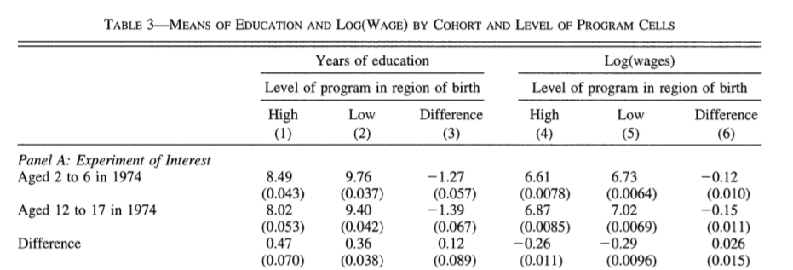
Program Effect on Education
Higher education in low intensity areas as part of INPRES mandate
Education grew more for those in high‐intensity areas where more schools were built (Note: std error implies insignificant)
Notes:
This is the results table from Duflo's paper. It tells us two things about the program’s effect on years of education.
First, the children in areas of high program intensity had lower years of education and wages, which confirms the fact that the INPRES program did target areas which had low educational attainment.
And second, the difference in differences calculation comes out to be 0.12, which you can interpret to mean that one extra school per 1000 children, increased education by 0.12 years.

Slide 138
In both types of regions, average educational attainment increased over time. However, it increased more in regions that received more schools. The difference in these differences can be interpreted as the causal effect of the program, under the assumption that, in the absence of the program, the increase in educational attainment would not have been systematically different in low and high regions.
Duflo (2001)
Notes:
This is Duflo’s summary of her findings from the difference in differences table.
And it reads as follows:
In both types of regions, average educational attainment increased over time. However, it increased more in regions that received more schools. The difference in these differences can be interpreted as the causal effect of the program, under the assumption that, in the absence of the program, the increase in educational attainment would not have been systematically different in low and high regions.
As Duflo later notes, it turns out that this estimate of the causal effect of the INPRES program derived by difference in differences, is statistically imprecise, meaning that it’s not a very reliable estimate.
Duflo writes, and I quote, “the remainder of this paper will elaborate this strategy to lead to more convincing results.”
She uses an instrumental variables analysis as her second approach to get, in her own words, more convincing results.
Thankfully, you know all about instrumental variables analysis from the earlier module, so feel free to check it out in your own time.

Slide 139
Potential Pitfalls of Difference-in-Differences
Parallel Trends Assumption
DD does not identify the treatment effect if treatment and control groups were on different trajectories prior to intervention
Differential trends in subsection of the population (unbiased for just the local group)
Concomitant Treatments
Confounding events (e.g. other laws and programs implemented)
Pre-treatment Trends Policy makers intervene to improve a bad condition; therefore treatment effect can be biased (also see Ashenfelter dip)
Manipulate Treatment Assignment
People may migrate such that the population resident in the treatment group before and after the policy is different
Notes:
Before we forget, let’s cover the potential downsides of difference in differences.
The first problem is rooted in the parallel trends assumption. The difference in differences technique does not identify the treatment effect, if the treatment and control groups were on different trajectories prior to the treatment.
The second problem is concomitant treatments, also known as confounding events. The idea here is that there are many laws and programs which are being implemented, so there is of course a good chance that we are picking up the effect of one or more of these confounders and not the actual treatment we care about.
The third problem is the idea of there being pre-treatment trends. For example, there is a commonly observed phenomenon called the Ashenfelter dip, where there is a decrease in earnings or employment levels in the periods leading up to a treatment. A pre-treatment “dip” that is specific only to treated units, would create bias in difference in differences studies.
The fourth problem is the manipulation of treatment assignment. For example, our subjects in the treatment group may migrate such that the population resident in the treatment group before and after the treatment period is different.

Slide 140
Further Studies on Difference-in-Differences
Semiparametric Difference-in-Differences Estimators
Abadie (2005)
Water for Life: The Impact of the Privatization of Water Services on Child Mortality
Galiani et al. (2005)
How much should we trust differences-in-differences Estimates?
Bertrand et al. (2004)
Do Conditional Cash Transfers Improve Child Health? Evidence from PROGRESA’s Control Randomized Experiment
Gertier (2004)
Estimating the Effect of Training Programs on Earnings
Ashenfelter (1978)
Notes:
Difference in differences is one of the most popular techniques that is being used today to discover causal relationships.
Therefore, it’s important that we supplement our current understanding of difference in differences with some canonical resources to help us become experts.

Slide 141
Final
Concluding remarks and congratulations

Slide 142
5 Techniques for Causal Inference
You’ve got some amazing tools there, buddy!
Notes:
Congratulations! In just the span of an hour, we covered 5 causal inference techniques, and examples of them being employed in the real world.
So let’s summarize, what have we just accomplished?

Slide 143
The Tools
Randomized Experiment
Controlled Regression
Instrumental Variables
Regression Discontinuity
Difference-in-Differences
Notes:
We learned about randomized experiment, controlled regression, instrumental variables analysis, regression discontinuity, and difference-in-differences

Slide 144
The Moral Lesson?
Causal inference is tough because it takes some detective work
In assessing the literature, we will want to read empirical work with a critical eye
Don’t be the lazy analyst who just nods
Notes:
The moral lesson with all of this? Well, causal inference is pretty tough. Each of our techniques comes with its own set of positives and negatives. And it’s only by thinking critically, that we can better judge which methods to use in different contexts.

Slide 145
Final
Thank You!
Any questions?
You can find me at
@dhexonian
dhexonian@outlook.com
Notes:
I thank you so much for joining me, and it’s truly been a pleasure talking about causal inference with you.
If you have any questions, feel free to reach out. You can find me on Twitter, and at my email.

Slide 146
Credits
Many thanks to all the people who made creating this course an enjoyable process
Grace McCormack (economist/advisor)
Sung-Min Kim (copy editor)
Antonela Carpena (illustrator)
Matt Polly (text-to-speech, voice)
Emily Glassberg Sands (inspiration)
Matthew Masten (inspiration)
Andrew Ng (inspiration)
Elizabeth Choe (inspiration)
Katharine Kormanik (inspiration)
Notes:
Last but not least, I want to thank those who have made creating this course an enjoyable process.
Thank you so much.

Slide 147
References
Acemoglu, Daron, Simon Johnson, and James A. Robinson (2001): The Colonial Origins of Comparative Development: An Empirical Investigation, The American Economic Review, 91, 1369-1401.
Sandra E. Black; Do Better Schools Matter? Parental Valuation of Elementary Education, The Quarterly Journal of Economics, Volume 114, Issue 2, 1 May 1999, Pages 577–599, https://doi.org/10.1162/003355399556070
Angrist, Joshua David., and Jörn-Steffen Pischke. Mostly Harmless Econometrics: An Empiricist's Companion. Princeton: Princeton University Press, 2009.
A Finkelstein, S Taubman, B Wright, M Bernstein, J Gruber, JP Newhouse, The Quarterly Journal of Economics 127 (3), 1057-1106
Banerjee, Abhijit, Esther Duflo, Rachel Glennerster, and Cynthia Kinnan. 2015. "The Miracle of Microfinance? Evidence from a Randomized Evaluation." American Economic Journal: Applied Economics, 7(1): 22-53.
Wooldridge, Jeffrey M. Econometric Analysis of Cross Section and Panel Data. Cambridge, Mass: MIT Press, 2002. Print.
Rubin, Donald B. (1973): Matching to Remove Bias in Observational Studies,Biometrics, 29, 159-83.
Judea Pearl; Causal diagrams for empirical research, Biometrika, Volume 82, Issue 4, 1 December 1995, Pages 669–688, https://doi.org/10.1093/biomet/82.4.669
Imbens, Guido, and Joshua Angrist (1994): Identification and Estimation of Local Average Treatment Effects, Econometrica, 62, 467-476.
Imbens, Guido, and Thomas Lemieux (2008): Regression Discontinuity Designs: A Guide to Practice, Journal of Econometrics, 142, 615-635.
Angrist, Joshua D., and Alan B. Krueger (1991): Does Compulsory Schooling Attendance Affect Schooling and Earnings?,Quarterly Journal of Economics, 106, 976-1014.
Duflo, Esther (2001). “Schooling and Labor Market Consequences of School Construction in Indonesia: Evidence From an Unusual Policy Experiment,” American Economic Review, Sept 2001

Slide 148
Creative Commons
Copyright © 2018 by Labor Studios
All rights reserved.
Limit of Liability/Disclaimer of Warranty: While the publisher and author have used their best efforts in preparing this title, they make no representations or warranties with respect to the accuracy or completeness of the contents of this title and specifically disclaim any implied warranties of merchantability or fitness for a particular purpose.
THE WORK (AS DEFINED BELOW) IS PROVIDED UNDER THE TERMS OF THIS CREATIVE COMMONS PUBLIC LICENSE 3.0 UNPORTED LICENSE. THE WORK IS PROTECTED BY COPYRIGHT AND/OR OTHER APPLICABLE LAW. ANY USE OF THE WORK OTHER THAN AS AUTHORIZED UNDER THIS LICENSE OR COPYRIGHT LAW IS PROHIBITED.
BY EXERCISING ANY RIGHTS TO THE WORK PROVIDED HERE, YOU ACCEPT AND AGREE TO BE BOUND BY THE TERMS OF THIS LICENSE. TO THE EXTENT THIS LICENSE MAY BE CONSIDERED TO BE A CONTRACT, THE LICENSOR GRANTS YOU THE RIGHTS CONTAINED HERE IN CONSIDERATION OF YOUR ACCEPTANCE OF SUCH TERMS AND CONDITIONS.

